Slide 1
BIG BEAD Full Application
Webinar Grant Training
January 21, 2025

Slide 2
Agenda
Introduction
Registration and pre-application review
BIG BEAD application requirements and scoring
  General requirements
  Project area selection, project descriptions, and scope of work
  Labor and workforce
  Technology, speed, and scalability
  Affordability
  Local and regional coordination
  Financial capability
Grant application portal instructions
Permitting, reporting, compliance
Q&A

Slide 3
Introduction

Slide 4

Broadband Infrastructure Grant (BIG)
Broadband Equity, Access, and Deployment Grant (BEAD)
Connect 100% of unserved locations with reliable broadband
Utah’s allocation: $317.4M - Fiber first / second other technologies
Registration and Pre-application mandatory to participate for the BIG BEAD
Registration and Pre-application information pre-populates to full application.
Full application will open January 29, 2025 and close March 31, 11:59 PM

Slide 5
Broadband Infrastructure Grant (BIG)
Broadband Equity, Access, and Deployment Grant (BEAD)
Utah Project Funding Areas (UPFA) published Jan 15, 2025
Applicants can submit one or multiple applications to the program
Applications can have one or multiple UPFA
UPFA can have one or multiple technology proposals
broadband.utah.gov https://business.utah.gov/broadband/grants/

Slide 6
BIG BEAD Formal Application Information
What you’ll need:
Proof of an active SAM.gov registration.
Valid Utah business license
Utah’s Government Records Access and Management Act (GRAMA)
  All proprietary, financial, or other sensitive data is protected including:
  Trade Secrets
  Commercial or Financial Information
  Personal Information
Registration
The first person who registered for your company’s account will be the administrator of your account and will be able to invite other users to view and add to the system.
Notes:
BIG: Broadband Infrastructure Grant

Slide 7
Application Support
January 15: Utah Project Funding Areas published
January 16: In-Person Grant Application Training
January 21: Virtual Grant Application Training
January 28-March 25: Weekly Virtual Trainings and Office Hours
January 29: Application portal opens
March 31: Application portal closes (tentative)
  In depth webinars presenting information on critical topics
FAQs updated weekly
Email connectingutah@utah.gov
Call 801-538-8680

Slide 8
Application Resources
Link to application portal
Application guide
Link to Utah Project Funding Area Map
Downloadable csv file with broadband serviceable locations per project funding area
Frequently Asked Questions
Specific topic info pages
Recorded training webinar
Weekly virtual office hours

Slide 9
Timeline
Registration & Pre-application portal opened
Formal application opens
Awards finalized and published
October 22, 2024
January 2025
Summer/Fall 2025
December 23, 2024
March 2025
Pre-application portal closes
Formal application closes

Slide 10
Registration and Pre-Application Review

Slide 11

Registration and Pre-application Results
43 pre-applications submitted
Completeness reviews
Curing period (5 business days)
Risk assessment reviews
Full application eligibility
  A list of pre-registered applicants will be posted at https://business.utah.gov/broadband/grants/
Notes:
certify by an authorized officer of the prospective subgrantee and be approved by their governing board that the Prospective Subgrantee:
Financially qualified to meet project obligations
Will have available funds for project costs exceeding the amount of the grant
Will comply with all program requirements and milestones
Letter of Credit/Performance Bondprior to entering into any subgrantee agreement, UBC will require prospective subgrantees to submit a letter from an eligible bank (see 47 C.F.R. § 54.804(c)(2)) in which the bank commits to issuing an irrevocable standby letter of credit to the prospective subgrantee.
NTIA Programmatic Waiver
Audited financial statements from previous fiscal year, audited by independent CPA
Sustainability/Pro Forma Analyses including at least three years of operating cost and cash flow projections post-project

Slide 12
Registration and Pre-application Results
Common risk assessment findings:
  No cybersecurity or supply chain risk management plans in place (REQUIRED for BEAD awardees)
  Expired UEI numbers or inactive sam.gov registration (active registration REQUIRED for BEAD awardees)
  Insufficient or incomplete financial information
  Business licenses or certifications not confirmed
  Workforce credentials not provided or not confirmed
  Missing or incomplete organization information
  Risk scores will be provided*

Slide 13
Pre-application to Formal Application
712 Utah Project Funding Areas (UPFA)
1,074,960 Served | 17,716 Underserved | 25,823 Unserved
  Approximately $302 million available
  Estimated ave cost per location: $13,000-15,000
  Multiple technologies needed
UBC will determine the extremely high cost per location threshold after subgrantee applications are submitted. The threshold will be set at a level that permits selection of non-fiber-to-the-home applications that provide the best available technology for reaching the unserved locations.
Notes:
EHCPL Definition: Cost per location above which UBC can decline a proposal in favor of an alternative technology that meets technical requirements if the alternative technology would be less expensive.

Slide 14
Full Application Process
Formal Application Period
Second Round
Last Chance Round

Slide 15
Subgrantee Selection Process
Round 1
Applicants can submit multiple proposals for the same project area; for fiber, “other,” and “alternative” technologies.
Round 2
Depends on the results of round 1
  Eligible applicants for locations where
    Indicated in the pre-app they were applying but did not
    Applied in the formal grant for adjacent UPFA
    Incumbent in or near the UPFA
Last Chance Round
Any eligible entity can submit a proposal or register if they haven’t done so and submit
Notes:
EHCPL Definition: Cost per location above which UBC can decline a proposal in favor of an alternative technology that meets technical requirements if the alternative technology would be less expensive.

Slide 16

Formal Application
Update or add to previous registration documentation.
Additional documentation required:
Notes:
certify by an authorized officer of the prospective subgrantee and be approved by their governing board that the Prospective Subgrantee:
Financially qualified to meet project obligations
Will have available funds for project costs exceeding the amount of the grant
Will comply with all program requirements and milestones
Letter of Credit/Performance Bondprior to entering into any subgrantee agreement, UBC will require prospective subgrantees to submit a letter from an eligible bank (see 47 C.F.R. § 54.804(c)(2)) in which the bank commits to issuing an irrevocable standby letter of credit to the prospective subgrantee.
NTIA Programmatic Waiver
Audited financial statements from previous fiscal year, audited by independent CPA
Sustainability/Pro Forma Analyses including at least three years of operating cost and cash flow projections post-project

Slide 17
BIG BEAD Application Requirements

Slide 18
Application Requirements
General Requirements: Requirements that all subgrantees will need to abide by per the federal BEAD Notice of Funding Opportunity and Utah’s Initial Proposal Volume 2
Scoring Criteria: Application elements that will be awarded points; used to evaluate applications submitted for the same Utah Project Funding Areas

Slide 19
Application Scoring
Definitions
Priority Broadband Project: Project proposing to construct end-to-end fiber optic facilities to all broadband-serviceable locations in an UPFA
Other Last Mile Broadband Deployment Project: Project that do not propose to construct end-to-end fiber optic facilities to all broadband-serviceable locations in an UPFA

Slide 20
Scoring Rubric - Primary & Secondary Criteria
Priority Broadband Projects
Criteria | Weight
Minimal BEAD Outlay - Match & Cost per location | 50%
Affordability (Middle Class) - $70 - $142.75 | 15%
Fair Labor Practices | 10%
Speed to Deployment | 8%
Local & Tribal Gov’t Coordination | 6%
Community Impact | 7%
Workforce Development & Job Quality (min/women-owned hires & subs opportunities) | 3%
Open Access Networks | 1%
Notes:
Beginning on page 23
Primary Criteria. In deciding among competing Priority Broadband Projects covering the same location or locations, Eligible Entities must give the greatest weight (e.g., substantial points or credits) to the following criteria:Minimal BEAD Outlay, affordability Fair Labor Practices. Secondary Criteria is Speed to Deployment with other optional categories.
Match 25% = 0 pts to 70%+ = 45 pts / NTIA High-cost areas Match 5% = 5 pts to 45% = 45 points. Affordability $70 = 15 pts $142.75 = 1 pt / Cost per Location =, $3,000 = 5 pts to $9,001 to EHCPLT = 0
Fair labor points from .5 to 5 in 6 categories to total up to 10 pts.
Secondary Criteria points cannot exceed lowest point category of Primary Criteria.
Fair labor 0-1 yrs - 4 pts 3-<4 yrs = 1 pt & Documentation 1 pt ea up to 4 pts in 5 categories of documentation (proof of ROW, pole attachments access, towers, easement’ franchise agreement of permit process underway; engineering design; inventory or bill of sale; other applicable.
Local coordination: Minutes = 3 pts; agenda - 1 pt & Resolution of Support or other approved formal demonstration of consent from local government leaders= 2 pts
Community Impact 3 pts. “innovative means of providing a public benefit that addresses the community’s needs and includes a long-term benefit. Must demonstrate extensive community engagement & local planning including evidence of locally held outreach meetings such as open town hall with residents and businesses ( 1 pt); Signed letters of support from community organizations referencing the long-term benefit = 3 pts. Service to CAIs, community facility not a CAI, economically distressed area, digital literacy training, low-income assistance, partner with or establish co-working space, increase adoption including low-cost offerings for 3 yrs, open community WiFi
Middle Class: pp. 101 - 103Each year the FCC publishes a monthly broadband price benchmark for fixed service. This benchmark is
used to ensure recipients of high-cost universal service have at least one fixed (non-mobile) broadband
service below this rate. For example, the 2023 FCC Urban Rate Survey Broadband Methodology Report
rate for 100/20 Mbps with an unlimited capacity allowance (GB) is $105.03. The FCC’s national
urban benchmark for 1Gbps/500Mbps is $142.75.

Slide 21
Scoring Rubric
Other Last Mile Broadband Deployment Projects
Criteria | Weight
Minimal BEAD Outlay - Match & Scalability & Resiliency | 50%
Affordability (Middle Class) - $60 - $105.03 | 15%
Fair Labor Practices | 10%
Speed to Deployment | 4%
Speed of Network and Other Technical Capabilities | 6%
Local and Tribal Gov’t Coordination | 7%
Community Impact | 7%
Open Access Networks | 1%
Notes:
Match for 100/20 30% = 5 pts to 55% = 30 pts.
The scalability and resiliency scoring category is based if the network design is more scalable or resilient than what is considered to be industry standard–Route diversity, redundancy, protective measures, scalability in network design for future growth and tech advancement. 5 pts for ea category up to 20 pts.
Affordability for 100/20 $60 or less 15 pts to $105.03 for 2 pts
Fair labor practices same as Priority Projects
Secondary Criteria
Speed to Deployment 0-1 yr = 3 ts to <4 yr = 1 pt & documentation 1 pt
Speed of Network & Other Technical Capabilities based on technology eg. Hybrid fiber coaxial 6 pts, Hybrid fiber-fixed wireless using licensed spectrum 5 pts, to Fixed wireless with licensed spectrum 4 pts. Alternate technologies = unlicensed fixed wireless 100/100 service 2 pts; 100/20 = 1 pt. LEO = 0
Local community Coordination 4 pts (minutes = 3 pts; agenda 1 pt) Resolution 3 pts
Community Impact and Open Access same as Priority Projects
Each year the FCC publishes a monthly broadband price benchmark for fixed service. This benchmark is
used to ensure recipients of high-cost universal service have at least one fixed (non-mobile) broadband
service below this rate. For example, the 2023 FCC Urban Rate Survey Broadband Methodology Report
rate for 100/20 Mbps with an unlimited capacity allowance (GB) is $105.03. The FCC’s national
urban benchmark for 1Gbps/500Mbps is $142.75.

Slide 22
Privacy and Confidentiality
The application is designed in compliance with Utah laws regarding data privacy.
Government Data Privacy Act, Utah Code §§ 63 A-19-101, et seq.
  “A governmental entity must provide a personal data request notice to anyone from whom the governmental entity requests or collects personal data. The governmental entity may only use personal data furnished by an individual for the purposes identified in the personal data request notice.”

Slide 23
Privacy and Confidentiality
Governmental Internet Information Privacy Act, Utah Code §§ 63 A-19-101, et seq.
  “The privacy policy must contain:
    the identity of the governmental website operator and how the governmental website operator may be contacted;
    the PII collected by the governmental entity
    a summary of how the PII is used;
    the practices related to disclosure of the PII;
    the procedures by which a user of a governmental entity may:
      request access to their PII; or
      request that their PII be corrected; and
    a general description of the security measures in place to protect a user’s PII from unintended disclosure.”

Slide 24
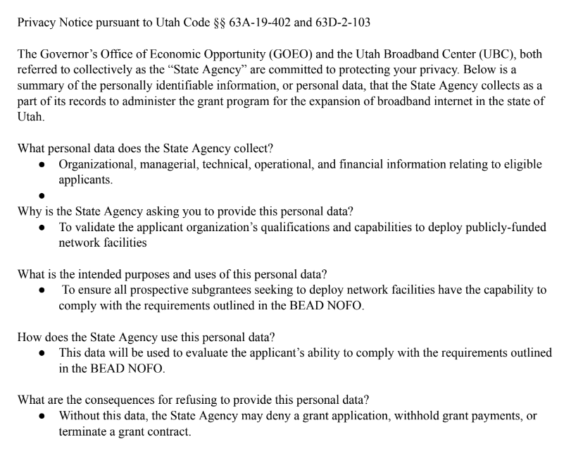
The full privacy notice for the BIG BEAD application can be accessed here.
Notes:
https://drive.google.com/file/d/1H_MKLurLyLhj3PxhD6Snxr8i6oMbU3oI/view?usp=drive_link

Slide 25

General Requirements
Managerial Capability (submitted during pre-application)
Operational Capability (submitted during pre-application)
Ownership (submitted during pre-application)
Other Public Funding (submitted during pre-application)
Notes:
Utah IP Volume 2 has details about these categories.
Required documentation for these categories were submitted in the registration and pre-application. Supplemental documentation to support your application in these categories may be submitted with the full application if you choose to do so.

Slide 26
General Requirements
Financial Capability (to be covered later in the presentation)
  Letter of Credit/Performance Bonds Managerial Capability
  Pro Forma Analysis
Technical Capability (to be covered later in the presentation)
  Network design and diagrams
  Project build out timeline and milestones
Compliance with environmental and BABA requirements (to be covered later in the presentation)
Notes:
Utah IP Volume 2:
UBC understands the need to ensure that American taxpayer dollars are spent procuring needed products and supplies from American workers and businesses and minimizing the impacts from building in areas where environmental and/or historic preservation may be of concern.
UBC will ensure adherence to the requirements of Build America, Buy America Act (BABA), the National Environmental Policy Act (NEPA) (42 U.S.C. § 4321 et seq.) and National Historic Preservation Act (NHPA) (54 U.S.C. § 300101 et seq.). UBC will communicate requirements stipulated in the Acts noted above to all prospective subgrantee prior to the selection process. This will be completed by conducting outreach (webinars, in-person meetings, etc.) to participating stakeholders, posting a list of regulations on the Connecting Utah website, and including these requirements in grant application instructions and grant agreement terms, conditions and monitoring program requirements.
Specific to BABA compliance efforts, UBC will ensure the following key points are highlighted:
● Requirements that all iron, steel, manufactured products (including but not limited to fiber-optic communications facilities), and construction materials used in the project or other eligible activities are produced in the United States unless a waiver is granted.
● In determining whether a product is produced in America, prospective subgrantees must comply with definitions included in Section 70912 of the Build America, Buy America Act, which provides that a manufactured product is considered produced in the United States if the manufactured product was manufactured in the United States and the cost of the components of the manufactured product that are mined, produced, or manufactured in the United States is greater than 55 percent of the total cost of all components of the manufactured product, unless another standard for determining the minimum amount of domestic content of the manufactured product has been established under applicable law or regulation.
● In addition to the provisions above, prospective subgrantees may not use BEAD funding to purchase or support any covered communications equipment or service, as defined in Section 9 of the Secure and Trusted Communications Networks Act of 2019 (47 U.S.C. § 1608).
● The Infrastructure Act expressly prohibits subgrantees from using BEAD funding to purchase or support fiber optic cable and optical transmission equipment manufactured in the People’s Republic of China unless a waiver of this requirement is received from the Assistant Secretary.
UBC will also permit prospective subgrantees to utilize the BEAD Program Build America, Buy America Waiver released by NTIA in February 2024, along with any additional waivers approved by NTIA. Additional guidance regarding Build America, Buy America compliance will be provided as it is made available by NTIA.
Specific to NEPA and NHPA compliance efforts, including Section 106 compliance, UBC will ensure the following key points are highlighted:
● Prospective subgrantees will describe how they will comply with applicable environmental and national historical preservation requirements.
● Prospective subgrantees will obtain all necessary federal, Eligible Entity, and local governmental permits and approvals necessary for the proposed work to be conducted based on the timeline for implementation for project areas.
● Projects and other eligible activities are expected to be designed so that they minimize the potential for adverse impacts on the environment.
UBC will formulate specific intake questions to evaluate the viability and compliance of a proposed application. Prospective subgrantees will be required to provide plans that show compliance with the Acts noted above and will only be eligible to participate in the subgrant process once compliance is determined. Because adhering to these requirements is necessary to participate in any BEAD funding grant rounds, engagement with stakeholders is critical for success. UBC will encourage prospective subgrantees to engage with numerous federal, state and local stakeholders, including but not limited the following:
● Federal land and resource managing agencies, including but not limited to the National Park Service, the U.S. Fish and Wildlife Service, the Bureau of Land Management, the National Marine Fisheries Service, the U.S. Army Corps of Engineers, the U.S. Coast Guard, the U.S. Forest Service and others in order to understand any restrictions or special conditions that may apply to infrastructure proposed on federal land, or that may impact federally managed resources such as wetlands, threatened or endangered species, navigable waterways and others.
● Coordination with state and local agencies that may have a role in EHP requirements, such as the State Historic Preservation Office, as well as state or local agencies that may need to issue their own permits for any proposed projects.
UBC recognizes the importance of compliance with the Acts noted above and ongoing monitoring of the subgrantees to ensure compliance. UBC will ensure preparedness for compliance requirements with BABA once further guidance is finalized by NTIA. The office will ensure preparedness for compliance requirements with NEPA and NHPA through the following steps:
● Review of available resources and requirements:
○ Familiarity with the EHP requirements and additional guidance in the BEAD NOFO.
○ Understanding of the requirements of the NEPA review process and the NHPA review process.
○ Review the NEPA, Historic Preservation, and Climate Resilience Webinar and presentation materials
● Sourcing of EHP focused staff or contractors:
○ Demonstrate the readiness of the broadband team to analyze potential environmental impacts.
○ If necessary, hire additional staff or contractor support to ensure the broadband team has the appropriate capacity and expertise to manage EHP activities.
○ Designate certain individuals to be specifically responsible for EHP activities. Outline their responsibilities associated with managing EHP and NEPA review activities.
○ Invite collaborators or SMEs to support their team.
● Outline an approach for EHP activities:
○ Outline steps and activities necessary to ensure that the prospective subgrantees understand the requirements to comply with NEPA.
○ Coordinate with other state offices that have experience administering federal grants, such as the Utah Department of Transportation, to identify best practices and approaches for managing the NEPA review process.
○ Identify subcontractors they may engage to support with potential environmental assessments.
○ Share best practices for developing a project description that provides enough detail about the potential impacts to the environment to make a preliminary determination about the level of NEPA review required.
Documentation related to the requirements above will be collected and reviewed by qualified personnel. As needed, UBC will hire additional staff or contractors to ensure there is appropriate capacity and expertise to adequately review the documentation and provide a third-party perspective of the requirements noted above. Applications that do not show intent to abide by BABA and EHP requirements, or that explicitly violate the requirements, will not be considered eligible to receive BEAD funding.

Slide 27

General Requirements
Compliance with Laws
  Demonstrate compliance with all applicable Federal, State, and Local laws, including but not limited to the following legal topics:
Employment Safety and Health (OSHA) Underground Plant Protection Use of Public ROW Consumer privacy Cybersecurity Compliance with Utah Code Title 54, Public Utilities Code Truth in Billing Deceptive Trade Practices And more!
Notes:
Utah IP Volume 2:
At the time of formal application, UBC will require prospective subgrantees to demonstrate capability of fulfilling funded activities competently and complying with all applicable federal, state, territorial, and local laws. The prospective subgrantee will be required to demonstrate compliance, including, but not limited to, the following legal topics:
Employment
Safety and Health (OSHA)
Underground Plant Protection (Blue Stakes of Utah 811)
Siting of wireless infrastructure
Use of Public ROW
Consumer Privacy
Cybersecurity (data breach notification)
FCC (ACP participation)
Utah Department of Commerce
Compliance with Utah Code Title 54, Public Utilities Code
Subgrantee Registrations with regulatory agencies
Truth in Billing
Deceptive Trade Practices
Nondiscrimination in service areas
Building on Tribal lands
Lobby laws
Prospective subgrantees may provide written internal procedures, required compliance reports, reports of violations and their remedies, audit reports etc. as evidence of demonstrated compliance with all applicable laws. In addition, the prospective subgrantee must identify the key management personnel responsible for legal compliance, i.e., Chief Compliance Officer.
Any legal actions taken against the subgrantee resulting from non-compliance with any federal, state, territorial, or local laws resulting in judgment or that are pending litigation against the prospective subgrantee in the three (3) years prior to the submission of an application must be disclosed and documented. If the prospective subgrantee operations are unionized, any union actions reaching the Chief Compliance Officer or key management personnel level must be disclosed and documented.

Slide 28

General Requirements
Compliance with Laws
  Demonstrate occupational safety and health requirements adherence
    Verify that workers are permitted to create worker-led health and safety committees
    Verify that key management personnel will meet with these committees upon reasonable request (within 10 business days)
    Describe your process for promoting these committees
Notes:
Utah IP Volume 2:
At the time of the formal application, prospective grantees will verify they permit workers to create worker-led health and safety committees that key management personnel will meet upon reasonable request. UBC requires the prospective subgrantee to describe their process for promoting worker-led health and safety committees.
A prospective subgrantee with existing worker-lead health and safety programs must describe the program and document past meetings with key management personnel. Prospective subgrantees with union contracts must disclose terms and conditions in the contract applying to worker-led health and safety committees.
A prospective subgrantee must document the reasonable time provided for during working hours for the worker-led health and safety committees to meet independently of key management personnel on prospective subgrantee premises. Key management personnel of the prospective subgrantee must respond to a reasonable request to meet with the worker-led health and safety committees within 10 business days of the request. No retaliation by the prospective subgrantee is permitted to the worker-led health and safety committee or its members.
Under no circumstances does a worker-led health and safety committee mitigate compliance with all applicable federal, state, territorial, and local laws.

Slide 29

General Requirements
Network Capabilities
  Deliver reliable broadband service with speeds of at least 100/20 Mbps
  95% of latency measurements must be at or below 100 ms
  Network outages should not exceed, on average 48 hours over 365-day period
Notes:
BEAD NOFO pages 64-70 https://broadbandusa.ntia.doc.gov/sites/default/files/2022-05/BEAD%20NOFO.pdf
Eligible Entities shall ensure that any subgrant agreement for a Funded Network permits the subgrantee to use the subgrant to deploy broadband infrastructure in or through any area required to reach interconnection points or otherwise to ensure the technical feasibility and financial sustainability of a project providing broadband service to an unserved location, underserved location, or Eligible Community Anchor Institution.
Pursuant to Section 60102(g)(1)(A) of the Infrastructure Act, which directs the Assistant Secretary to establish quality-of-service standards to which each subgrantee must comply, each Eligible Entity shall ensure that every Funded Network meets the following criteria:
To ensure that Funded Networks meet current and future use cases and to promote consistency across federal agencies, NTIA adopts the compliance standards and testing protocols for speed and latency established and used by the Commission in multiple contexts, including the Connect America Fund and the Rural Digital Opportunity Fund.78 In order to demonstrate continued compliance with these standards, subgrantees must perform speed and latency tests from the customer premises of an active subscriber to a remote test server at an end-point consistent with the requirements for a Commission-designated IXP.79
Subject to the exceptions identified in Section IV.B.7.a, Funded Networks shall deliver Reliable Broadband Service with speeds of not less than 100 Mbps for downloads and 20 Mbps for uploads.80 In addition, 95 percent of latency measurements during testing windows must fall at or below 100 milliseconds round-trip time.81 This approach ensures a connection that supports reasonably foreseeable real-time applications. In the limited circumstance where even a fiber deployment cannot achieve this latency threshold (for example in a remote territory), NTIA may expand the latency threshold for specific Funded Networks at the request of an Eligible Entity.
Funded Network connections to Eligible Community Anchor Institutions shall be capable of delivering service at speeds not less than 1 Gigabit per second for downloads and 1 Gigabit per second for uploads.82 Eligible Entities shall ensure that such connections can be used to provide business data services.83
Each Funded Network’s outages should not exceed, on average, 48 hours over any 365-day period except in the case of natural disasters or other force majeure occurrence. Each Eligible Entity should ensure a prospective network is designed to meet this requirement and should develop metrics for measuring outages to be utilized in connection with this requirement once the network is operational.

Slide 30

General Requirements
Deployment requirements
  Network deployed and service provided within four years of receiving the subgrant
  Conduit Access Points for underground/roadway fiber cables
Notes:
BEAD NOFO pages 64-70 https://broadbandusa.ntia.doc.gov/sites/default/files/2022-05/BEAD%20NOFO.pdf
Eligible Entities shall ensure that each subgrantee deploys its Funded Networks and begins providing broadband service to each customer that desires broadband service not later than four years after the date on which the subgrantee receives the subgrant for the applicable network.84 Eligible Entities shall establish interim buildout milestones, enforceable as conditions of the subgrant, sufficient to ensure that subgrantees are making reasonable progress toward meeting the four-year deployment deadline. Eligible Entities may, following consultation with the NTIA and with the approval of the Assistant Secretary, extend the deadlines under this subparagraph if the Eligible Entity reasonably determines that (i) the subgrantee has a specific plan for use of the grant funds, with project completion expected by a specific date not more than one year after the four-year deadline; (ii) the construction project is underway; or (iii) extenuating circumstances require an extension of time to allow the project to be completed.
Any Funded Network deployment project that involves laying fiber-optic cables or conduit underground or along a roadway must include interspersed conduit access points at regular and short intervals for interconnection by unaffiliated entities. Where a project proposes to lay conduit, Eligible Entities shall require prospective subgrantees to propose to deploy a reasonable amount of excess conduit capacity and to propose a conduit access point interval as part of the grant application process and shall consider the adequacy of the prospective subgrantee’s proposed excess conduit capacity and access points when evaluating the application.

Slide 31
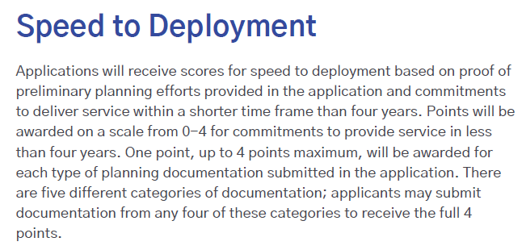

Speed to Deployment Scoring–Priority Broadband Projects

Slide 32
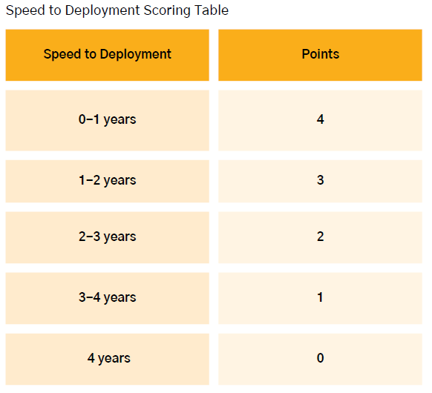
Speed to Deployment Scoring–Priority Broadband Projects
Subcategory | Points Possible
Speed to Deployment | 4
Documentation | 4
Total: | 8

Slide 33
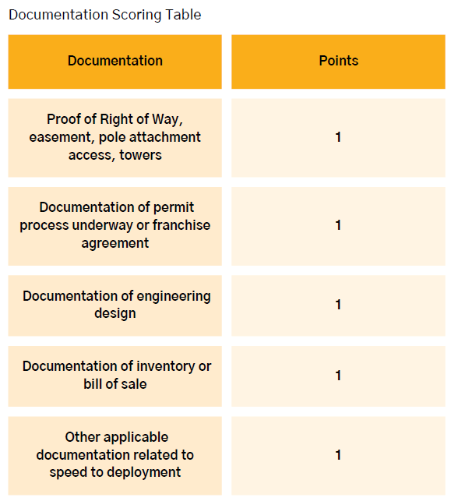
Speed to Deployment Scoring–Priority Broadband Projects

Slide 34
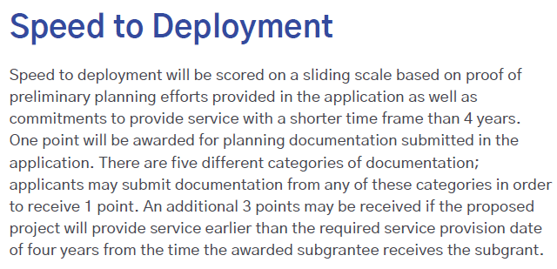
Speed to Deployment Scoring–Other Last Mile Broadband Deployment Projects

Slide 35
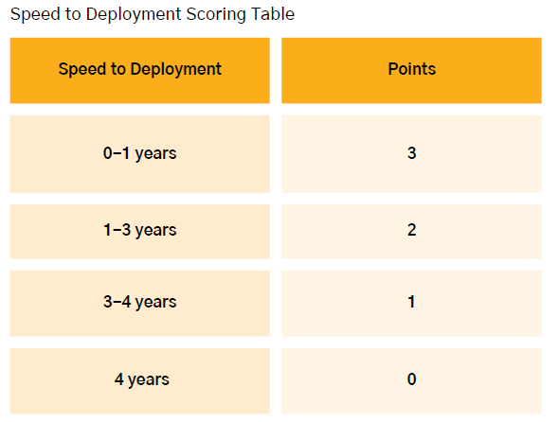
Speed to Deployment Scoring–Other Last Mile Broadband Deployment Projects
Subcategory | Points Possible
Speed to Deployment | 3
Documentation | 1
Total: | 4

Slide 36
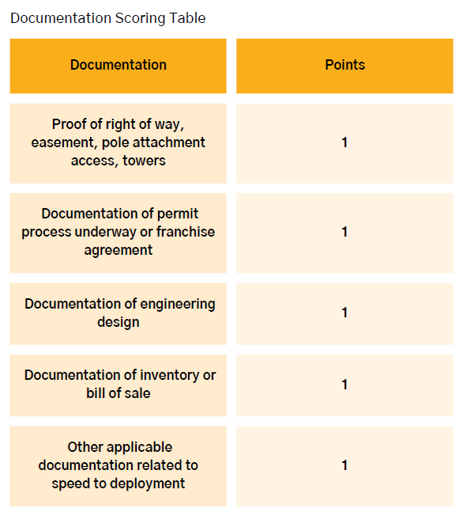
Speed to Deployment Scoring–Other Last Mile Broadband Deployment Projects

Slide 37

General Requirements
Service obligations requirements
  Affordability and low-cost plans (covered later in this presentation)
  No data usage caps or unreasonable network management practices
  Provide broadband service on reasonable and non-discriminatory terms and conditions
  Provide public notice and public awareness campaigns of broadband service availability
Notes:
BEAD NOFO pages 64-70 https://broadbandusa.ntia.doc.gov/sites/default/files/2022-05/BEAD%20NOFO.pdf
The Infrastructure Act’s BEAD provisions are premised on Congress’s determination that “[a]ccess to affordable, reliable, high-speed broadband is essential to full participation in modern life in the United States,” and that “[t]he persistent ‘digital divide’ in the United States is a barrier to” the nation’s “economic competitiveness [and the] equitable distribution of essential public services, including health care and education.”85 Accordingly, each Eligible Entity must include in its Initial and Final Proposals a middle-class affordability plan to ensure that all consumers have access to affordable high-speed internet. We expect that Eligible Entities will adopt diverse strategies to achieve this objective. For example, some Eligible Entities might require providers receiving BEAD funds to offer low-cost, high-speed plans to all middle-class households using the BEAD-funded network. Others might provide consumer subsidies to defray subscription costs for households not eligible for the Affordable Connectivity Benefit or other federal subsidies. Others may use their regulatory authority to promote structural competition. Some might assign especially high weights to selection criteria relating to affordability and/or open access in selecting BEAD subgrantees.86 And others might employ a combination of these methods, or other methods not mentioned here. Ultimately, however, each Eligible Entity must submit a plan to ensure that high-quality broadband services are available to all middle-class families in the BEAD-funded network’s service area at reasonable prices. Eligible Entities will be required to ensure that services offered over Funded Networks allow subscribers in the service area to utilize the ACP.
In addition, the Infrastructure Act requires that each subgrantee receiving BEAD funding to deploy network infrastructure offer at least one low-cost broadband service option. Each Eligible Entity must consult with the Assistant Secretary and prospective subgrantees regarding a proposed definition of the term “low-cost broadband service option.” Each Eligible Entity shall thereafter submit a proposed definition to the Assistant Secretary for approval in its Final Proposal. The Infrastructure Act directs the Assistant Secretary to define the subscribers eligible for such low-cost plans.
Eligible Entities must propose low-cost broadband service option parameters that best serve the needs of residents within their jurisdictions. Low-cost broadband service options must remain available for the useful life of the network assets. In crafting proposals, NTIA emphasizes that access to affordable broadband is among the Infrastructure Act’s objectives. In determining whether to approve an Eligible Entity’s proposed definition of “low-cost broadband service option,” the Assistant Secretary will consider, among other factors, (1) whether prospective subgrantees will be required to participate in the Affordable Connectivity Program, any successor program, and/or any other household broadband subsidy programs; (2) the expected cost (both monthly and non-recurring charges) to an Eligible Subscriber for a typical broadband internet access service plan after the application of any subsidies; and (3) the performance characteristics of the proposed options, including download and upload speeds, latency, data caps, and reliability commitments.
A definition of low-cost broadband service option should address, at a minimum: (1) all recurring charges to the subscriber, as well as any non-recurring costs or fees to the subscriber (e.g., service initiation costs); (2) the plan’s basic service characteristics (download and upload speeds, latency, any limits on usage or availability, and any material network management practices, (3) whether a subscriber may use any Affordable Connectivity Benefit subsidy toward the plan’s rate; and (4) any provisions regarding the subscriber’s ability to upgrade to any new low-cost service plans offering more advantageous technical specifications.
Each Eligible Entity shall ensure that each prospective subgrantee does not impose data usage caps on any plans offered over a Funded Network or impose unjust or unreasonable network management practices.89 Subgrantees shall certify through the semiannual reporting requirements described in Section VII.E of this NOFO that the plans offered over Funded Networks do not contain data usage caps for subscribers.
Operators of Funded Networks shall provide access to broadband service to each customer served by the project that desires broadband service on terms and conditions that are reasonable and non-discriminatory.
Eligible Entities shall require subgrantees to carry out public awareness campaigns in their service areas that are designed to highlight the value and benefits of broadband service in order to increase the adoption of broadband service by consumers. Awareness campaigns must include information about low-cost service plans and any federal subsidies for low-income households such as the Lifeline Program, the Affordable Connectivity Program, and any successor programs. Further, awareness campaigns must be conducted in an equitable and nondiscriminatory manner. Subgrantees must utilize a variety of communications media (e.g., online, print, radio) and provide information in languages other than English when warranted based on the demographics of the community.
Eligible Entities shall require that once a Funded Network has been deployed, each subgrantee shall provide public notice, online and through other means, of that fact to individuals residing in the locations to which broadband service has been provided and share the public notice with the Eligible Entity that awarded the subgrant. Each Eligible Entity shall require each prospective subgrantee seeking to deploy or upgrade network facilities to explain in its application how it intends to notify relevant populations of the new or newly upgraded offerings available in each area. Such proposals shall be designed in a manner that reflects any unique needs of the specific demographics of the area at issue (including, for example, languages prominently spoken in the area and the best means of ensuring that the population is likely to encounter the subgrantee’s public notice).

Slide 38

General Requirements
Service obligations requirements
  Funded projects deploying Middle Mile shall permit other ISPs to interconnect on a just, reasonable, and nondiscriminatory basis
  Cybersecurity and Supply Chain Risk Management–these plans must be either operational (if already providing service) or ready to be operationalized (if not yet providing service)
Notes:
BEAD NOFO pages 64-70 https://broadbandusa.ntia.doc.gov/sites/default/files/2022-05/BEAD%20NOFO.pdf
Any subgrantee receiving funds to deploy Middle Mile Infrastructure under this Program in connection with service to an Unserved Service Project or an Underserved Service Project shall permit other broadband service providers to interconnect with its funded Middle Mile Infrastructure network facilities on a just, reasonable, and nondiscriminatory basis. An Eligible Entity awarding funds for construction of Middle Mile Infrastructure shall require the subgrantee, via contract or other binding mandate, to allow such interconnection at any technically feasible point on the Middle Mile Infrastructure network (without exceeding current or reasonably anticipated capacity limitations). This duty includes, at a minimum, the physical interconnection of the subgrantee’s Middle Mile Infrastructure to a requesting party’s facilities for the exchange of traffic. In addition, subgrantees shall connect to the public internet directly or indirectly and provide requesting parties with an ability to connect to the internet. Rates and terms for interconnection shall be reasonable and nondiscriminatory. Each Eligible Entity shall require each subgrantee that obtains funding for the deployment or upgrade of Middle Mile Infrastructure to negotiate in good faith with any requesting party (including public, Tribal, private, non-profit, or other parties) making a bona fide request for interconnection. Subgrantees shall report through the subgrantee reporting process established in Section VII.E.2 of this NOFO any interconnection requests made to the subgrantee during that year and the status of those requests. In selecting subgrantees for last-mile deployments to Unserved Service Projects and Underserved Service Projects, NTIA encourages Eligible Entities to give preference to prospective subgrantees who commit to offering wholesale broadband services at rates and terms that are reasonable and nondiscriminatory.
Eligible Entities shall require that if a subgrantee, at any time, is no longer able to provide broadband service to the end user locations covered by the subgrant at any time on a retail basis remedial action be taken to ensure continuity of service. In consultation with NTIA, the Eligible Entity shall require the subgrantee to sell the network capacity at a reasonable, wholesale rate on a nondiscriminatory basis to one or more other broadband service providers or public-sector entities or sell the network in its entirety to a new provider who commits to providing services under the terms of the BEAD Program.90 The Eligible Entity may pursue either remedial action so long as such action results in continued retail service to end users in the grant area.
The Infrastructure Act directs the Assistant Secretary to specify prudent cybersecurity and supply-chain risk management practices for subgrantees deploying or upgrading broadband networks using BEAD funds. NTIA recognizes the importance of (a) protecting American communications networks and those who use them from domestic and international threat actors, and (b) promoting the natural evolution of cybersecurity and supply-chain risk management practices in a manner that allows flexibility in addressing evolving threats. To that end, we impose baseline requirements herein, though an Eligible Entity may propose additional measures it believes necessary to safeguard networks and users falling within its jurisdiction for consideration by the Assistant Secretary.
With respect to cybersecurity, prior to allocating any funds to a subgrantee, an Eligible Entity shall, at a minimum, require a prospective subgrantee to attest that:
1. The prospective subgrantee has a cybersecurity risk management plan (the plan) in place that is either: a. operational, if the prospective subgrantee is providing service prior to the award of the grant; or b. ready to be operationalized upon providing service, if the prospective subgrantee is not yet providing service prior to the grant award;
2. The plan reflects the latest version of the National Institute of Standards and Technology (NIST) Framework for Improving Critical Infrastructure Cybersecurity (currently Version 1.1) and the standards and controls set forth in Executive Order 14028 and specifies the security and privacy controls being implemented;
3. The plan will be reevaluated and updated on a periodic basis and as events warrant; and
4. The plan will be submitted to the Eligible Entity prior to the allocation of funds. If the subgrantee makes any substantive changes to the plan, a new version will be submitted to the Eligible Entity within 30 days. The Eligible Entity must provide a subgrantee’s plan to NTIA upon NTIA’s request.
With respect to supply chain risk management (SCRM), prior to allocating any funds to a subgrantee, an Eligible Entity shall, at a minimum, require a prospective subgrantee to attest that:
1. The prospective subgrantee has a SCRM plan in place that is either: a. operational, if the prospective subgrantee is already providing service at the time of the grant; or b. ready to be operationalized, if the prospective subgrantee is not yet providing service at the time of grant award;
2. The plan is based upon the key practices discussed in the NIST publication NISTIR 8276, Key Practices in Cyber Supply Chain Risk Management: Observations from Industry and related SCRM guidance from NIST, including NIST 800-161, Cybersecurity Supply Chain Risk Management Practices for Systems and Organizations and specifies the supply chain risk management controls being implemented;
3. The plan will be reevaluated and updated on a periodic basis and as events warrant; and
4. The plan will be submitted to the Eligible Entity prior to the allocation of funds. If the subgrantee makes any substantive changes to the plan, a new version will be submitted to the Eligible Entity within 30 days. The Eligible Entity must provide a subgrantee’s plan to NTIA upon NTIA’s request
An Eligible Entity also must ensure that, to the extent a BEAD subgrantee relies in whole or in part on network facilities owned or operated by a third party (e.g., purchases wholesale carriage on such facilities), obtain the above attestations from its network provider with respect to both cybersecurity and supply chain risk management practices.

Slide 39

General Requirements
Projects on Tribal Lands
  Formal demonstration of consent for proposed broadband deployment on Tribal Lands must be submitted at time of application
  Evidence of holistic coordination with Tribal Governments, showing that the project was developed in consultation with the Tribe
Notes:
Utah IP Volume 2:
Because of some of the unique situations in Utah and the relationship work that has been accomplished between the Tribes, ISPs and the State of Utah, UBC will submit to NTIA in the final proposal either a Resolution of Consent or other formal demonstration of consent used at the request of the Tribal Government from each Tribal Government’s Tribal Council or other governing body, upon whose Tribal Lands the infrastructure will be deployed. UBC will require that the resolution of consent, or any substitute document used at the request of the Tribal Government, be submitted by the applicant at the time of application along with other relevant documents demonstrating that holistic local coordination occurred. Relevant documents demonstrating holistic coordination between the Tribal Government and applicant, may include but are not limited to, current Tribal Business license and Tribal Access Permits issued by the Tribal Government to applicant or an executed agreement between the Tribal Government and applicant that grants applicant the ability to provide Broadband services on Tribal Lands. This will ensure that the proper documentation is obtained for submission and approval of the Final Proposal.
To ensure compliance and respect for Tribal sovereignty, the Utah Broadband Center (UBC) will adopt a meticulous and collaborative approach when planning projects that include locations on Tribal Lands. Here is an outline of the steps UBC will take to submit proof of Tribal Governments’ consent:
1. Engagement with Tribal Governments: UBC will engage directly with each Tribal Government to discuss the intended projects, ensuring that the projects align with the Tribes' needs and priorities and include the Tribe in the review process when awarding grant funds, unless they are the applicant.
2. Formal Documentation of Consent: UBC will request a formal demonstration of consent, such as a Resolution of Consent or other formal demonstration of consent, from the Tribal Council or other authorized governing bodies. This documentation will serve as an unequivocal expression of the Tribe's approval of the proposed broadband deployment on their lands.
3. Submission Requirements for Applicants: Applicants proposing projects on Tribal Lands will be required to submit the formal demonstration of consent from the relevant Tribal Government at the time of their application. This will be a mandatory part of the application process to ensure all proposed projects have the necessary Tribal approval before any further consideration.
4. Verification of Holistic Local Coordination: Alongside the consent documents, applicants will need to submit evidence of holistic local coordination, demonstrating that the project has been developed in consultation with the Tribal Governments and that it addresses their specific broadband needs.
5. Compilation for Final Proposal: UBC will compile all resolutions of consent, letters of support, and other relevant documents from each Tribal Government for submission to the National Telecommunications and Information Administration (NTIA) as part of the Final Proposal package.
6. Continuous Communication: Throughout the process, UBC will maintain open lines of communication with Tribal Governments to ensure that any feedback or additional requirements are addressed promptly and respectfully. By following these steps, UBC will confirm that the deployment of broadband infrastructure on Tribal Lands is conducted with full consent and collaboration of Tribal Governments, thereby upholding Tribal sovereignty and ensuring a community-centric approach to broadband expansion.

Slide 40
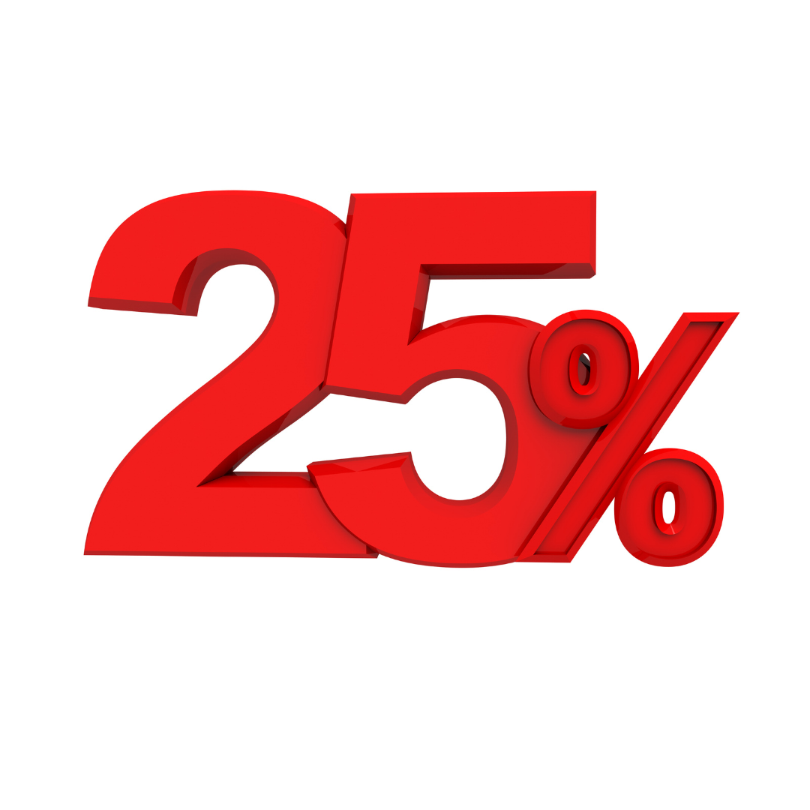
General Requirements
Matching Funds
  25% minimum match of total project cost is required
  Cash or in-kind match is permitted (in-kind must comply with 2 CFR 200.306)
  Matching funds waivers may be requested in high cost areas; all waivers must be approved by NTIA
Notes:
BEAD NOFO page 3:
L. Cost Sharing/Matching Except in certain specific circumstances described herein (including projects in designated “high-cost areas,” as defined in Section 60102(a)(2)(G), and other cases in which NTIA has waived the matching requirement pursuant to Section 60102(h)(3)(A)(ii)), for each broadband deployment project utilizing BEAD grant funding, each Eligible Entity shall provide, require its subgrantee to provide, or provide in concert with its subgrantee, matching funds of not less than 25 percent of project costs. Funds from federal programs, including funds from the Commission’s Universal Service Fund programs, generally may not be used as matching funds; however, the Infrastructure Act expressly provides that matching funds for the BEAD Program may come from a federal regional commission or authority and from funds that were provided to an Eligible Entity or a subgrantee for the purpose of deploying broadband service under the Families First Coronavirus Response Act (Public Law 116-127; 134 Stat. 178); the CARES Act (Public Law 116-136; 134 Stat. 281), the Consolidated Appropriations Act, 2021 (Public Law 116-260; 134 Stat. 1182); or the American Rescue Plan Act of 2021 (Public Law 117-2; 135 Stat. 4), to the extent permitted by those laws. See Section III.B of this NOFO for more information pertaining to the cost sharing requirements for this Program.
Utah IP Volume 2:
UBC may consider a waiver for the matching funds criteria. Determined on a case-by-case basis, a full or partial waiver may be granted. To be eligible for a waiver, an applicant must submit a proposal with more than 80% of BSLs in the project area located in regions defined as High-Cost Areas by NTIA. UBC may request additional matching fund waivers from NTIA to incentivize areas that are not applied for during the first round of subgrantee selection.
If an application’s affordability offering could be improved (i.e., the cost of the match is offset by a higher cost to potential subscribers), a waiver may be granted. Those requesting a waiver must demonstrate the effect of affordability to potential subscribers by submitting pro forma financials with different capex assumptions based on different matching fund requirements, which shows the impact on subscriber rates to achieve average revenue per customer (ARPC). The appropriate Utah affordability threshold will be determined by UBC.
To the extent NTIA shall allow additional waivers, including but not limited to the Extremely High Cost per Location threshold, UBC reserves the right to consider any and all waivers for subgrantees. All waivers will be submitted to NTIA for review and approval.

Slide 41
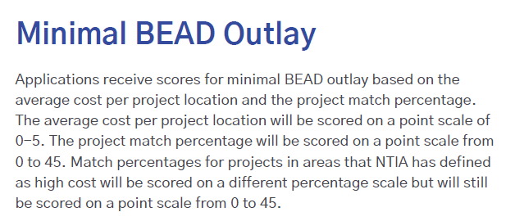
Minimal BEAD Outlay Scoring–Priority Broadband Projects

Slide 42
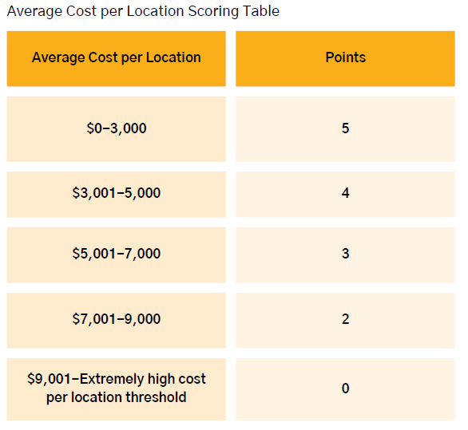
Minimal BEAD Outlay Scoring–Priority Broadband Projects
Subcategory | Points Possible
Average Cost per Location | 5
Match Percentage | 45
Total: | 50

Slide 43
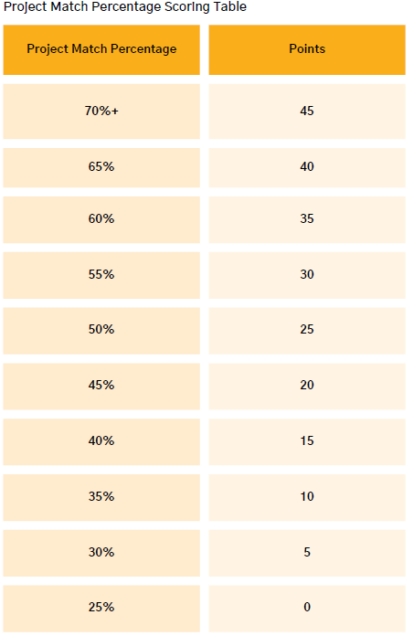
Minimal BEAD Outlay Scoring–Priority Broadband Projects

Slide 44
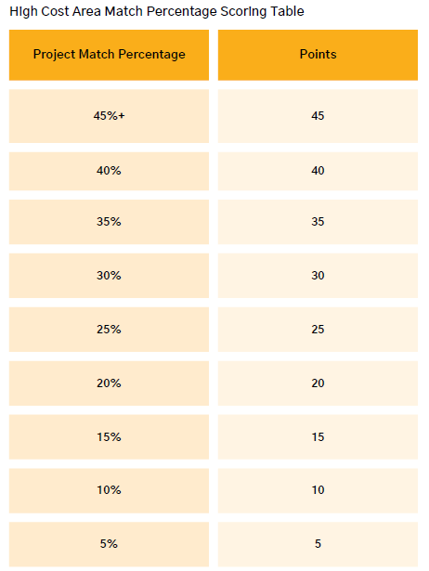
Minimal BEAD Outlay Scoring–High Cost Area Priority Broadband Projects

Slide 45
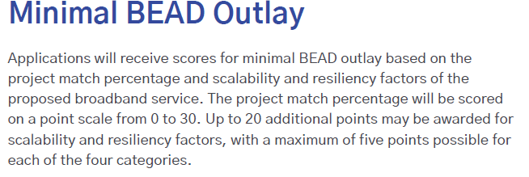
Minimal BEAD Outlay Scoring–Other Last Mile Broadband Deployment Projects

Slide 46
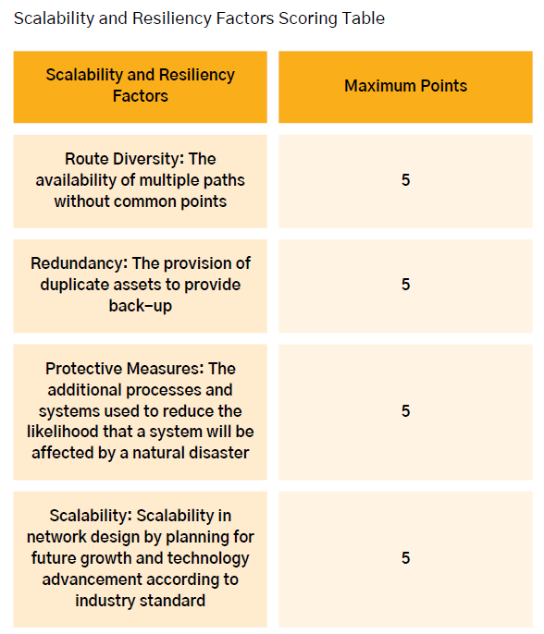
Minimal BEAD Outlay Scoring–Other Last Mile Broadband Deployment Projects
Subcategory | Points Possible
Scalability and Resiliency | 20
Match Percentage | 30
Total: | 50

Slide 47
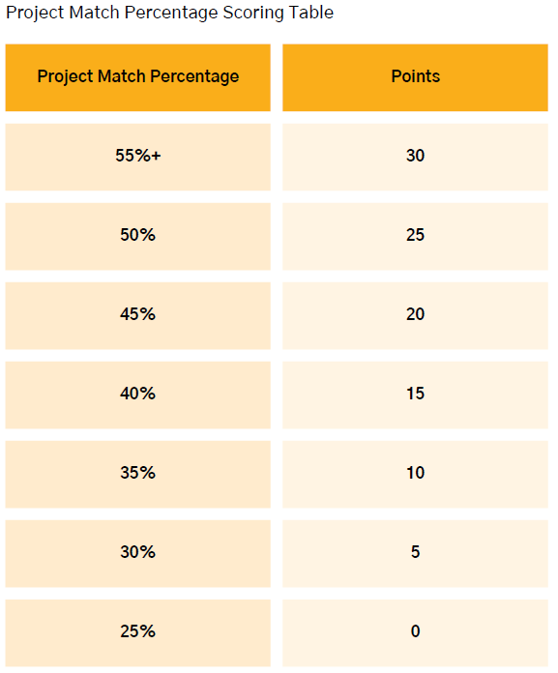
Minimal BEAD Outlay Scoring–Other Last Mile Broadband Deployment Projects

Slide 48
Project Area Selection
Review of UBC’s UPFA Stratagem.
Notes:
UBC will deconflict project areas through a pre-application process which is required for any entity that
plans to apply for BEAD funds. With each pre-application, the applicant will complete a .csv template
provided by UBC of census blocks (CB) where there are unserved or underserved locations for which the
applicant intends to apply through the BEAD program. During the pre-application, applicants will be able
to provide any narrative, explanation, or details to indicate any advantages or challenges, high-cost
barriers, overlapping service areas, access to infrastructure, any possible constraints of serving an entire
CB, or any other factor they wish to share regarding a CB for which they wish to apply. UBC will then
review all pre-applications and develop Utah Project Funding Areas (UPFAs). During the creation of the
UPFAs, UBC will identify any CB not chosen that contains unserved or underserved locations, and either
group them with other CBs as is feasible or will identify them as unique project areas, in accordance with
the criteria included in Project Funding Areas in 2.1.4. CBs that are included in multiple pre-applications
will be identified as unique project areas. Following the 60 calendar days of the pre-application
submission deadline, the UBC will publish the eligible Utah Project Funding Areas (UPFA) prior to the
Priority and Other Last-Mile Deployment Projects application round. During this application round,
applicants will be required to identify each UPFA they want to apply for, and include project-specific
information for each UPFA (including budget, technical specifications, etc.). Applicants will only be
required to submit their organizational information (including financial capability, managerial capability,
etc.) once. During the application review process, the review committee will review applications for each
UPFA and make an award for each UPFA. It is likely that applicants who apply for multiple UFPAs may
only receive awards for some of the UPFAs they apply for. This process of identifying where two or more
applicants are proposing to serve the same locations and requiring like-applications be submitted to serve
those same locations allows for direct comparison of competing applications. Ultimately, application
areas may be as small as one location.

Slide 49
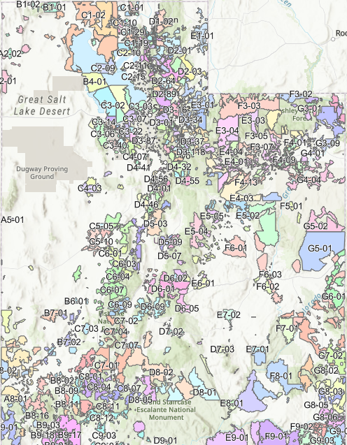
Utah Project Funding Areas - UPFA
Tribal areas
Cost models
Terrain
Exchanges
Pre-application
High cost
Posted for 14 days prior to grant opening
Map
Notes:
EHCPL Definition: Cost per location above which UBC can decline a proposal in favor of an alternative technology that meets technical requirements if the alternative technology would be less expensive.

Slide 50
Project Descriptions
The Project Description is a short description that could be released to the public should a project award be made. The Project Narrative is a more detailed presentation of the project. For example, requiring information such as:
Project’s Community Benefit
Service Offerings
Technology Type
Upgrades to Existing Networks
Design Parameters
Areas of Risk
Network Maintenance

Slide 51
Scope of Work
  The Scope of Work describes the activities and services to be performed for the project.
  Describe specific project activities to be undertaken as part of the project
  Who will carry out the work
  Construction schedule with milestones

Slide 52
Labor and Workforce
What is required to know with relation to labor practices.
The applicant must upload a document, signed by an officer of the applicant company, responding to the following questions covering the period of January 1, 2022, until the date of application submission (unless otherwise specified):

Slide 53
Labor Practices
What steps have you taken to comply with federal labor and employment laws as they relate to broadband deployment projects?
Have you had any violations of federal labor or employment laws since January 1, 2019?
Have your contractors or subcontractors had any violations of federal labor or employment laws since January 1, 2019?
What are your wage schedules for positions that will be involved in the BIG BEAD-funded project?
Do you have a workplace safety policy? If yes, include a copy of the policy.
Notes:
UBC will require applicants to submit the following information during the application period of the
competitive subgrantee selection process:
1. Applicants’ record of past compliance with federal labor and employment laws, which:
○ Must address information on these entities’ compliance with federal labor and
employment laws on broadband deployment projects in the last three years;
○ Should include a certification from an Officer/Director-level employee (or equivalent) of
the applicant evidencing consistent past compliance with federal labor and employment
laws by the applicant, as well as all contractors and subcontractors; and
○ Should include written confirmation that the applicant discloses any instances in which it
or its contractors or subcontractors have been found to have violated laws such as the
Occupational Safety and Health Act, the Fair Labor Standards Act, or any other
applicable labor and employment laws for the preceding three years.
2. Applicants’ plans for ensuring compliance with federal labor and employment laws, which must
address the following:
○ How the applicant will ensure compliance in its own labor and employment practices, as
well as that of its contractors and subcontractors, including:
○ Information on applicable wage scales and wage and overtime payment practices for each
class of employees expected to be involved directly in the physical construction of the
broadband network; and
○ How the applicant will ensure the implementation of workplace safety committees that
are authorized to raise health and safety concerns in connection with the delivery of
deployment projects.13
New entrants without a three-year record of federal labor and employment law compliance will be
permitted to make binding legal commitments to strong labor and employment standards and protections
regarding BEAD-funded projects.
If prospective subgrantees, including new entrants, fail to provide certification, confirmation, and/or a
binding commitment, the application will be denied.
During the competitive subgrantee selection process, UBC will make the determination that information
submitted suffices for the purposes of the federal BEAD requirements. See section 2.4.2 for more
information regarding scoring of Fair Labor Practices during the subgrantee selection process.

Slide 54
Labor Practices
Who can sign for your company:?
The document must include a statement certifying your compliance with federal labor and employment laws for the BIG BEAD funded project. This statement must be signed by an officer of the company who is authorized to legally bind the applicant to this federal compliance.
What if your company is fairly new without experience with labor law compliance?
New entrants without a three-year record of federal labor and employment law compliance will be permitted to make binding legal commitments to strong labor and employment standards and protections regarding BIG BEAD-funded projects. Such binding legal commitments must align with the above-listed items.

Slide 55
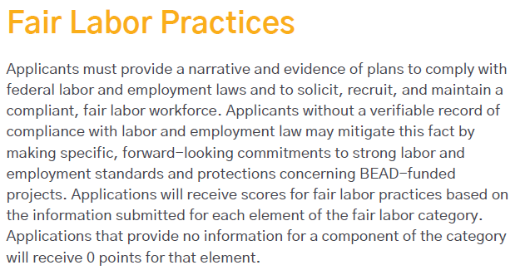
Fair Labor Practices Scoring–Priority Broadband Projects

Slide 56
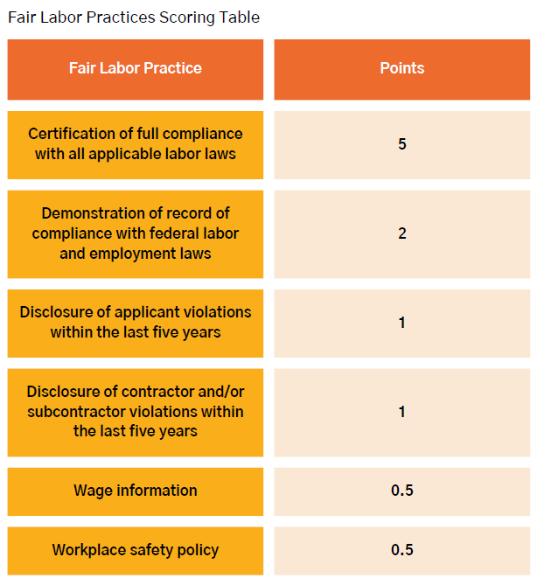
Fair Labor Practices Scoring–Priority Broadband Projects

Slide 57
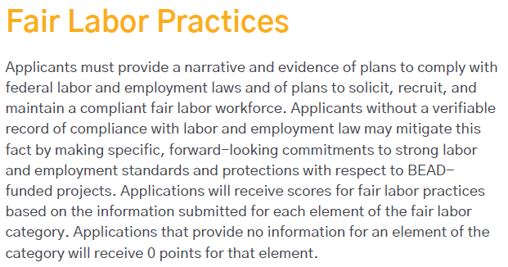
Fair Labor Practices Scoring–Other Last Mile Broadband Deployment Projects

Slide 58
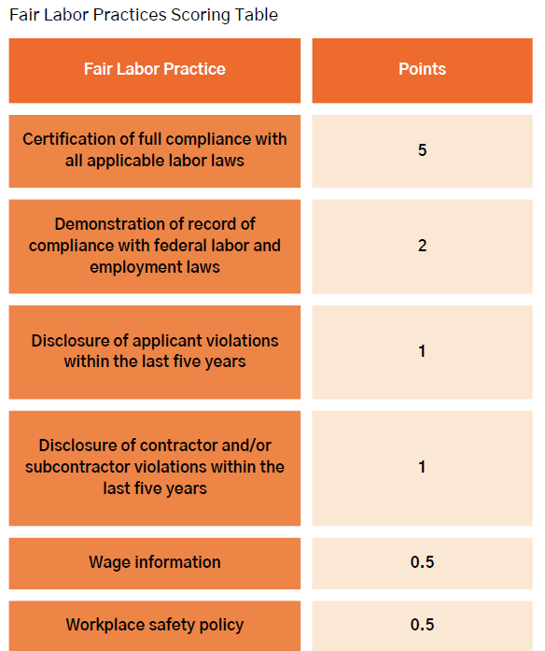
Fair Labor Practices Scoring–Other Last Mile Broadband Deployment Projects

Slide 59
Workforce Development
Did you include a plan for outreach and engagement with workforce development and/or minority and women owned businesses in your Project Description? WBE/MBE
Did you include a plan for hiring a local workforce in your Project Description?
Evidence:
Upload any letters of support that demonstrate your engagement with workforce development or minority and women owned business agencies.

Slide 60
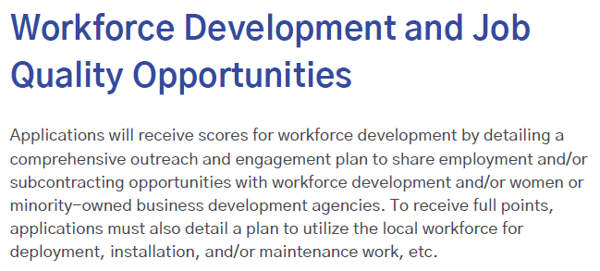
Workforce Development Scoring–Priority Broadband Projects

Slide 61
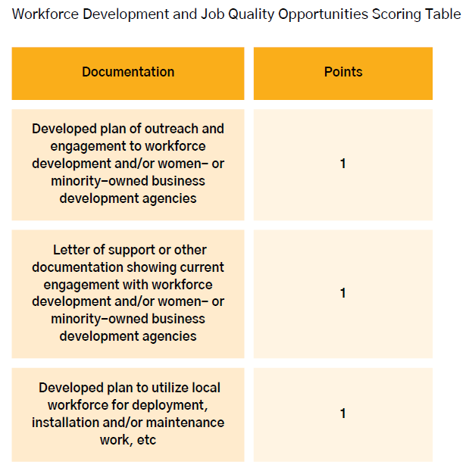
Workforce Development Scoring–Priority Broadband Projects

Slide 62
Additional Labor Requirements
This information will not be scored but will be evaluated to ensure that all those employed to deploy BIG projects have received adequate training.
The project workforce plan must address each of the following elements:
Strategies will be used to ensure that an appropriately skilled workforce aligns with the project’s requirements and industry norms.
A statement affirming whether or not the workforce is unionized. While UBC does not require applicants to utilize a unionized workforce, applicants must state whether or not they will be using a unionized workforce for the proposed project.
A statement affirming whether the workforce will be directly employed or subcontracted.

Slide 63
Recommended Labor Practices
a. Using a directly employed workforce, as opposed to a subcontracted workforce.
b. Paying county prevailing wages and benefits to workers, including compliance with Davis-Bacon and Related Acts requirements, where applicable, and collecting the required certified payrolls.
c. Using project labor agreements (i.e., pre-hire collective bargaining agreements between unions and contractors that govern terms and conditions of employment for all workers on a construction project).
d. Use of local hire provisions.
e. Commitments to union neutrality.
f. Use of labor peace agreements.
Notes:
2.7.2 COMPLIANCE WITH FEDERAL LABOR AND EMPLOYMENT LAWS
Describe in detail whether the Eligible Entity will make mandatory for all subgrantees
(including contractors and subcontractors) any of the following and, if required, how it
will incorporate them into binding legal commitments in the subgrants it makes (See
heading a through i of Section 2.7.2 below):
The Governor’s Office of Economic Opportunity Grant Contract Standard Terms and Conditions requires
compliance with state and federal labor and employment law. Specifically, with regard to Subsection 2.7.2
(i) "Taking steps to prevent the misclassification of workers." The Utah Labor Commission monitors and
enforces misclassification of employees (for example, a contractor hires someone to work as a 1099
independent contractor, when in reality that person is working as an employee, and should be classified
78
for payroll taxes as an employee).
UBC encourages applicants to provide the following information to UBC as evidence to support the
applicant’s operational and managerial capability. These items will not be included in legally binding
commitments, nor in the application scoring process.
a. Using a directly employed workforce, as opposed to a subcontracted workforce.
b. Paying county prevailing wages and benefits to workers, including compliance
with Davis-Bacon and Related Acts requirements, where applicable, and collecting
the required certified payrolls.
c. Using project labor agreements (i.e., pre-hire collective bargaining agreements
between unions and contractors that govern terms and conditions of employment
for all workers on a construction project).
d. Use of local hire provisions.
e. Commitments to union neutrality.
f. Use of labor peace agreements.
g. Use of an appropriately skilled workforce (e.g., through registered apprenticeships
or other joint labor-management training programs that serve all workers,
particularly those underrepresented or historically excluded).
h. Use of an appropriately credentialed workforce (i.e., satisfying requirements for
appropriate and relevant pre-existing occupational training, certification and
licensure).
i. Taking steps to prevent the misclassification of workers.
UBC will ensure subgrantees are aware of these items prior to and throughout the selection process by
conducting regulations information webinars, posting a list of regulations on the Connecting Utah
website, and including the requirements in grant applications/instructions as well as grant agreement
terms/conditions and subrecipient grant monitoring program requirements.

Slide 64
Recommended Labor Practices(cont)
g. Use of an appropriately skilled workforce (e.g., through registered apprenticeships or other joint labor-management training programs that serve all workers, particularly those underrepresented or historically excluded).
h. Use of an appropriately credentialed workforce (i.e., satisfying requirements for appropriate and relevant pre-existing occupational training, certification and licensure).
Taking steps to prevent the misclassification of workers.

Slide 65
Fair Labor Acts
Occupational Safety and Health Act
Title VI of the Civil Rights Act of 1964
Title IX of the Education Amendments of 1972
The Americans with Disabilities Act of 1990
Section 504 of the Rehabilitation Act of 1973
The Age Discrimination Act of 1975
Parts Il and III of Executive Order 11246. Equal Employment Opportunity
Executive Order 13166, Improving Access to Services for Persons with Limited English Proficiency.
Executive Order 13798, Promoting Free Speech and Religious Liberty (see also OMB M-20-09 Guidance Regarding Federal Grants and Executive Order 13798)
Notes:
Fair Labor Practices
Fair Labor Standards Act Establishment of minimum wage, overtime pay, recordkeeping,
and child labor standards affecting full-time and part-time
workers across private and public sectors
Occupational Safety and
Health Act
Establishment of safe and healthy workplace standards
Service Contract Act Establishment of standards for contractors and subcontractors
performing services on prime contracts in excess of 2,500
13 The Utah Labor Commission, Utah Occupational Safety & Health Office (UOSH), provides free consultation services to employers
to help identify safety and health hazards in the workplace and provide recommendations for correction. The goal of UOSHl is to
educate and assist employers and their employees in promoting safety and health in the workplace to prevent injuries and illnesses.
UOSH Consultation helps accomplish this without issuing citations or penalties. UOSH Consultation Services website:
https://laborcommission.utah.gov/divisions/uosh/consultation
77
Civil Rights and Nondiscrimination
Title VI of the Civil Rights Act
of 1964
(See also 15 C.F.R. Part 8)
Prohibition on discrimination on the basis of race, color, or
national origin under programs or activities receiving federal
financial assistance, including from the Department of
Commerce
Title IX of the Education
Amendments of 1972
Prohibition of discrimination on the basis of sex under federally
assisted education programs or activities
The Americans with
Disabilities Act of 1990
Prohibition of discrimination on the basis of disability under
programs, activities, and services provided or made available by
Eligible Entities and local governments or instrumentalities or
agencies thereto, as well as public or private entities that provide
transportation
Section 504 of the
Rehabilitation Act of 1973
Prohibition of discrimination on the basis of handicap under any
program or activity receiving or benefiting from federal assistance
The Age Discrimination Act
of 1975
Programs or activities receiving federal financial
assistance
Additional Authorities
Parts Il and III of Executive
Order 11246. Equal
Employment Opportunity
Requires that federally assisted construction contracts incorporate
and fulfill the nondiscrimination provisions of
§§ 202 and 203 of
E.O. 11246 and Department of Labor regulations implementing
E.O. 11246 (41 C.F.R. § 60-1.4(b))
Executive Order 13166,
Improving Access to Services
for Persons with Limited
English Proficiency
Requires federal agencies to examine the services that they provide,
identify any need for services to those with limited English proficiency
(LEP), and develop and implement a system to provide those services
so LEP persons can have meaningful access to them
Executive Order 13798,
Promoting Free Speech and
Religious Liberty (see also
OMB M-20-09 Guidance
Regarding Federal Grants
and Executive Order 13798)
States or other public grantees may not condition sub-awards of
federal grant money in a manner that would disadvantage grant
applicants based on their religious character

Slide 66
Workforce Final Thoughts.
UBC will not award BIG funding to applicants who fail to meet the minimum requirements essential to establish a skilled, diverse, and accredited workforce.

Slide 67
Technology, Speed, and Scalability
Priority Broadband Project
  1 Gig Symmetrical
Other Deployment Projects
  100/20
Alternative Technology
  100/20 - 100/100

Slide 68
Technology, Speed, and Scalability
Priority Broadband Project
  End-to-end fiber-optic
Other Deployment Projects
  Hybrid fiber coaxial
  Hybrid fiber-fixed wireless using licensed spectrum
  Fixed wireless using licensed spectrum
Alternative Technology
  Unlicensed fixed wireless or LEO

Slide 69
Technical Capability
Documentation (certified by Professional Engineer)
  Network design and diagram
  Detailed project costs
  Build-out timeline and milestones
  Capital investment schedule evidencing complete build-out and initiation of service within 4 years of receiving the subgrant (*points)
Notes:
Documentation to be provided by the prospective subgrantee at the time of Registration and Pre-application includes, but is not limited to, the following:
Documentation of current licensing with governing bodies to operate in Utah.
Documentation of current credentials of workforce from school(s) and verification from provider of work-related experience
Attestation of current Utah licensing for any engineers who certify design, diagrams, project costs, etc.
At the time of formal application, prospective subgrantees must submit certification to the UBC that they are technically qualified to complete and operate the Project. Documentation to be provided by the prospective subgrantee includes, but is not limited to, the following:
Project plan description that clearly identifies the steps (including but not limited to planning, design, implementation and operation) of the capital investment schedule. Project planning should include at a minimum:
Network design
Diagram
Project costs
Build-out timeline and milestones for project implementation
Capital investment schedule evidencing complete build-out and the initiation of service within four years of the date on which the entity receives the subgrant
Attestation that the proposed network can deliver broadband service that meets the requisite performance requirements to all locations served by the Project.
Following an award and prior to beginning the project, the network design and plan must be certified by a professional engineer, stating that the proposed network can deliver broadband service that meets the requisite performance requirements to all locations served by the Project.

Slide 70
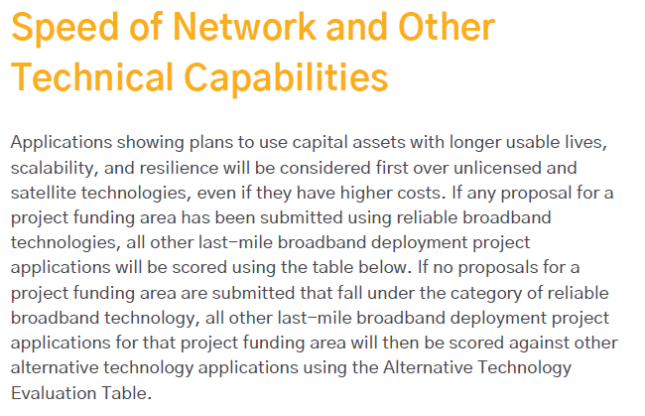
Speed of Network and Other Technical Capabilities Scoring–Other Last Mile Broadband Deployment Projects

Slide 71
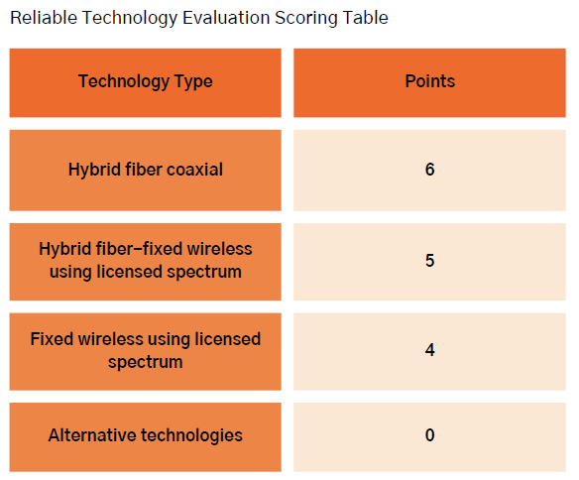
Speed of Network and Other Technical Capabilities Scoring–
Other Last Mile Broadband Deployment Projects

Slide 72
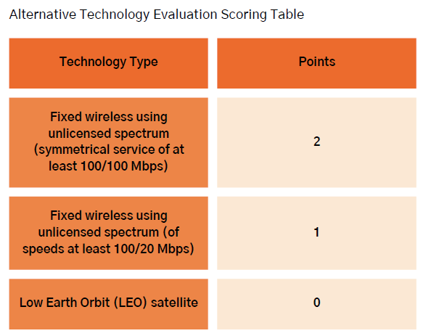
Speed of Network and Other Technical Capabilities Scoring–
Other Last Mile Broadband Deployment Projects

Slide 73
Affordability
Low-Cost Broadband Service Option
  Required for all subgrantees; not part of application scoring
Minimum requirements for low-cost option | Recurring monthly costs
100/20 Mbps consistent speeds Latency not higher than 100 ms No data caps or usage-based throttling Allow eligible subscribers to upgrade to new low-cost plan if one becomes available ACP eligible | No more than $60/month for eligible households in rural areas Rural low-income households may also access the following support: $9.25 Federal Lifeline $3.50 State Lifeline $7.00 State of Utah wholesale low-cost support for rural areas
 | No more than $30/month for eligible households in urban or non-rural areas
Notes:
IP Vol 2:
Adoption and affordability efforts are vital aspects of the success of BEAD projects. Applicants shall demonstrate the affordability of the products and services within the Proposed Funding Areas, addressing current barriers to broadband access in their project proposal. Applicants are encouraged to partner with housing agencies to leverage programs benefiting residents in multi-dwelling units. Applicants are required to participate in the FCC’s Affordable Connectivity Program (ACP) or its successor program if there is one. Applicants must include the following in their narrative:
1. Describe any activities planned to increase adoption awareness
2. Describe resources the applicant will be contributing to the adoption efforts, such as digital literacy training, marketing campaigns, surveys, and low-cost service options
3. Provide supporting documentation demonstrating the organization’s participation in subsidy programs to optimize digital inclusivity and adoption including partnering with school districts to raise awareness of subsidy programs such as Lifeline, Affordable Connectivity Program, the Emergency Connectivity Fund, or successor programs
While Utah boasts one of the lowest poverty rates in the nation at 8.2% based on 2022 statistics (https://www.statista.com/statistics/205703/poverty-rate-in-utah/), this does not necessarily reflect an accurate picture of the rate of poverty in many of the rural counties, especially in Tribal lands across the state. Because of the distance, terrain and remoteness of these areas, getting high-speed internet to rural and Tribal residents can be costly. This cost initially discourages providers from building infrastructure and when infrastructure is built, the costs are often passed onto the consumer. Based on Pew Charitable Trust’s article “Is Broadband Affordable for Middle-Class Families?”subscription rates in Utah vary based on counties’ median income. Subscription rates are as low as 59% in San Juan County, where the population averages 1.8 per square mile. ACP participation in San Juan County for eligible households was at 45% and many members of the Navajo Nation and San Juan Paiute Tribe living in San Juan County were able to afford internet service with the $75 ACP for Tribal households subsidy.
The telecom providers who are Eligible Telecommunications Carrier (ETC) are able to offset the costs of building in rural Utah with federal- and state-funded Universal Service Funds. This is a great benefit to consumers since the subsidy for construction costs and ongoing maintenance and operations costs keep monthly service fees affordable. However, not all rural providers are ETC and not all ETC providers are willing to build in many of the remote, high-cost rural areas due to a lack of business case to build out to these areas.
UBC acknowledges the higher costs associated with deploying broadband to these remote rural areas, while also recognizing the importance of low-cost service offerings for qualifying households to encourage adoption of broadband service across the state.
According to the FCC’s benchmark for affordable broadband, broadband service can be considered affordable when it costs no more than two percent of monthly disposable income. In 2022, the annual per capita disposable personal income for Utah was $49,632 (https://www.statista.com/statistics/1066324/utah-disposable-personal-income/ . Two percent of this amount would put the monthly service subscription rate at $82.72 per month.
For low-income households, defined in accordance with the former ACP eligibility guideline of 200% of the federal guideline, the disposable income rates (and therefore monthly service subscription rates) are lower. In Utah, the average household size is 2.99 (https://www.statista.com/statistics/242265/average-size-of-us-households-by-state/#:~:text=In%202021 %2C%20the%20average%20size,household%20size%20was%202.54%20people.). Two hundred percent of the federal poverty guidelines (https://aspe.hhs.gov/topics/poverty-economic-mobility/poverty-guidelines) for a household of three is $51,640 per year. Based on Utah’s flat rate 4.65% state income tax and assuming a federal income tax rate of $6,363 for a married filing jointly return at this income level (https://www.irs.gov/pub/irs-pdf/p17.pdf), the estimated disposable income for low income households is $43,483.74. Two percent of this amount is $72.47 per month.)
Based on research of subscriber’s fees and prevailing subscription fees in Utah, UBC has found that the majority of ISPs operating in the state offer low-cost service at rates below $82.72/month and even below $72.47/month. The average recurring monthly fees for 100/20 service have been offered for $60/month, which is lower than the $72.47/month rate reflecting two percent of disposable income for low income households. UBC conducted a formal survey of all ISPs serving in the state with the following question:
“According to NTIA guidelines, the State is required to set a dollar threshold for low-cost service options. Where would your company set a low-cost service option (dollar threshold, speeds, etc.)?”. The most common answer was: “We believe a $60/month option would be an affordable low-cost option in rural Utah. Low-income customers could qualify for the following support to further lower the monthly cost: $30/ACP; $9.25 Federal Lifeline; $3.50 State Lifeline; $7.00 State wholesale low-cost support. This would bring the monthly cost to $10.25. We believe customers should have some “buy in”. This low-cost option would be for a minimum of 100/20 service.
UBC expects BEAD-funded projects to continue offering low-cost service options and all subgrantees will be required to provide a low-cost service plan that meets the requirements described in this section. The maximum monthly recurrent charges to end-users inclusive of all taxes and fees and before applying any subsidies for the low-cost service option must be no more than $60 per month in rural areas and on Tribal Lands, and less than $30 in urban areas (or any area not defined as rural) for eligible households that qualify for ACP (or its successor program, if one exists). This low-cost service must offer no less than 100/20 Mbps, latency no greater than 100 ms and no data caps.
The $60/month rate in rural areas is significantly below the $72.47 affordability threshold for a family of 3 making 200% of the federal poverty guidelines. We recognize that $60/month nevertheless may be difficult to afford for households at lower income levels– for example households with income at 100% or 150% of the federal poverty guidelines. As explained above, however, UBC must balance the goal of affordability with the goal of robust participation in the BEAD program and the goal to ensure financially sustainable networks over the long term. UBC believes the rate of $60/month appropriately balances these goals in rural areas and a rate of $30/month appropriately balances these goals in non-rural areas.
The differences in cost between urban and rural areas are designed to accommodate the higher costs of construction and service provision in rural areas. The remaining 43,232 unserved locations out of 1,018,752 total BSLs in Utah are primarily rural and are arguably the most expensive to build and maintain. The state’s justification for disparate rates in rural and urban areas is based on the operating economics of the two distinct operating environments. Operating and ongoing maintenance costs in rural areas of Utah are significantly higher than those in the urban core along the Wasatch Front. A single “truck roll” to a remote rural location can involve hours of drive time, in addition to the service visit, and will bring a loss that will not be recouped by the provider through the lifetime of the service at the household even with a subsidy. Accordingly, a $30 per month differential in monthly prices provides support for the cost of operation in rural areas.
This monthly $30 rate differential is needed to ensure rural providers will maintain and operate their networks. Without the monthly price differential, long-term sustainability in rural areas would not be secure and thus potentially jeopardize the BEAD program objectives. Support for a differential rate in Utah is also found in the Federal Communications Commission’s national urban rate survey. The report for 2024 shows 100/20 Mbps unlimited service rate to be $66.26 per month. The FCC then adds $25.98 to account for variation across the national sample size and to set the rate rural carriers must meet. The data confirms the urban/rural disparity. Both the urban and the rural low-income rates (of $30/month and $60/month, respectively) are both below the 2% of disposable income benchmark for low income Utah households of $72.47/month.
For rural low-income customers, the following support may be used to further lower the monthly cost for Eligible Telephone Carriers (ETC):
$30/ACP
$9.25 Federal Lifeline
$3.50 State Lifeline
$7.00 State of Utah wholesale low-cost support for rural areas
All other providers are encouraged to provide similar discounts to low-income households they may serve with BEAD funds. These subsidies would bring the potential monthly cost to consumers in rural areas awarded to $10.25. Subsidies for tribal areas include ACP at $75/month and/or $34.24 for FCC Tribal Federal Lifeline. If ACP is defunded, the State of Utah does not currently have any other options to fund a program similar to the ACP. Requirements for BEAD recipients would remain as required in the current program. Providers will be encouraged to provide their own low-cost options to incentivize adoption rates in both rural and urban areas.
*RURAL DEFINITION Rural is defined by Utah Code 63N-2-103 as:
i. county of the third, fourth, fifth, or sixth class; or
ii. municipality that has a population of 10,000 or less and the municipality is in a county of the second class
Each low cost broadband service option shall provide at a minimum the following:
● 100/20 Mbps consistent speeds
● Latency no more than 100 ms
● No data caps or usage-based throttling
● Allow eligible subscribers to upgrade to a new low-cost plan at no cost if one becomes available
● Access to ACP(Affordable Connectivity Program) or any successor program
○ Subgrantees are required to show they offer an ACP eligible plan to all locations they serve in the state, not only BEAD awarded locations, prior to applying for BEAD
Over time, providers are likely, and are encouraged, to increase speeds and may need to make price changes in the normal course of business due to, among other things, increased costs. Providers may monitor economic trends and may request the UBC revisit and adjust for inflation and increased costs as needed such as government fees, especially in response to significant economic changes. Consideration for Economic Hardships: Low-income users or those facing economic hardships will be protected from price increases unless the Lifeline program or the ACP increases in equal step with any monthly service increases due directly to inflation.

Slide 74

Affordability
Middle Class Affordability
  Affordability is encouraged through:
    Application scoring criteria for open access in unserved communities
    Application scoring criteria for incentivized service plan
    Encourage subgrantees to provide the same affordable price tiers to all service areas in Utah
Notes:
IP Vol 2
Each year the FCC publishes a monthly broadband price benchmark for fixed service. This benchmark is used to ensure recipients of high-cost universal service have at least one fixed (non-mobile) broadband service below this rate. For example, the 2023 FCC Urban Rate Survey Broadband Methodology Report rate for 100/20 Mbps with an unlimited capacity allowance (GB) is $105.03.The FCC’s national urban benchmark for 1Gbps/500Mbps is $142.75.
Affordability of broadband services is a priority for UBC to fully ensure universal accessibility in addition to universal service for all Utahns. The UBC has established an office of Digital Access to collaborate with stakeholders to strategize ways to overcome barriers to access including affordable service plans. In conjunction with the members of the Utah Broadband Alliance, UBC seeks collaboration regarding ways to ensure universal access. Through the BEAD Infrastructure Grant (BIG) process, we are encouraging a robust competition and invite all interested providers large and small to participate. Entry is open and competitive and our office is open to discussion and negotiations. Utah has more than one successful model of open access that many of our cities have utilized to bring access and affordability to their citizens. UBC supports and encourages this model, but also understands the model will not work in all communities due to remoteness, density, or other factors. One point for open access will be given to applicants who can provide a strong model and show community support for it. UBC will not and does not intend to regulate rates, but as with any grant incentive of the Governor’s Office of Economic Opportunity which encourages economic growth, the UBC will provide incentives in the scoring to encourage the economic opportunities and overall wellbeing and quality of life for individuals desiring to participate fully in modern society with online access. The strategy of the UBC includes the following:
● BEAD subgrantee selection scoring criteria for open access in unserved communities where no less than 80% of the UPFA is unserved
● BEAD subgrantee selection scoring criteria for incentivized service plan
● Encourage subgrantees to provide the same middle-class affordability price tiers to all of its service areas within the state of Utah
BEAD Subgrantee Selection Scoring Criteria
While we respect the FCC’s urban benchmark, UBC believes the middle-class affordability standard in Utah can be better. To encourage economic growth and prosperity to its citizens while providing another competitive layer to the grant process to ensure a service provider dedicated to the needs of the community, additional points can be obtained through offering lower monthly cost options. The points assigned to affordability in the scoring criteria established in the Subgrantee Selection Scoring are a means to ensure high-quality broadband services will be made available to all middle-class families in the BEAD-funded network’s service area at reasonable prices and encourage all service providers to competitively provide similar or better rates to their non-BEAD-funded areas.
Affordability will form 15% of the total available scoring to prospective subgrantees. Researching various providers’ websites serving Utah in both rural and urban, UBC was encouraged and pleased to find that many provided Gig symmetrical speed for $70 per month and has based the incentive on this benchmark. For each Project Funding Area, and based on the FCC’s national urban benchmark for 1Gbps/500Mbps, each applicant offering symmetrical gigabit service for $70, or less, per month, inclusive of all taxes, fees, and charges billed to the customer, will receive the full 15% scoring, while other applications will receive a percentage of points up to the urban benchmark of $142.75 reflective of the distance from the target price of $70 or less.
Recommended Service Plan
To be eligible to receive maximum points for affordability, the prospective subgrantees must provide the recommended service plan to the entire proposed Project Funding Area (i.e., the affordable low-cost option must be made available to all prospective customers anywhere within the Project Funding Area as well).
The recommended service plan must meet, at a minimum, the following criteria:
● Total package costs $70 per month or less, inclusive of all taxes, fees, and charges billed to the customer, for 1 Gbps service that consistently, verifiably, and reliably provides 1 Gbps download and upload speeds
● Total package costs $30 per month or less in urban areas and $60 or less in areas defined as rural*, inclusive of all taxes, fees, and charges billed to the customer, for 100/20 Mbps service that consistently, verifiably, and reliably provides 100 Mbps download and 20 Mbps upload speeds
● Must provide service installation within 10 business days of service request. Waivers for high cost, remote, seasonal homes will be considered. In areas where no technology other than LEO satellites are available or economically feasible, the monthly fee will be no more than $110/month.
● Provides latency measurements of no more than 100 milliseconds
● Is not subject to data caps, surcharges, or usage-based throttling, and is subject to the same acceptable use policies offered to other home subscribers of other internet access service plans
● Enforceable commitment to not raise the $60 per month for the 100/20 Mbps service for five years from the infrastructure deployment date for each BSL
● Enforceable commitment not to raise the Middle Class Affordability offering per month for the 1 Gbps symmetrical service for five years from the infrastructure deployment date for each BSL
● UBC recommends to provide service outage credits, measured at 1/30 of the monthly rate per day for an outage of over 12 hours
○ Will waive installation charges for any service installation that exceeds the 10-business day commitment
○ The plan is well-marketed, publicly available, and easily accessible
This recommended service plan applies to Priority Broadband Projects, Other Broadband Deployment Projects, and Hybrid Broadband Deployment Projects.
For middle-class affordability, Goal 5 of Utah’s Statewide Digital Equity Plan supports the adoption of affordable plans through coordinated outreach and digital navigator programs. This aligns with the middle-class affordability plans that require ISPs to provide plans meeting or exceeding the FCC's high-speed internet definition, which is crucial for households above the low-income threshold but still in need of affordable options.
The low-cost option, as well as all other offered plans, must be available for any ACP subsidy toward the plan’s rate. In High-Cost areas, as defined by the BEAD program, the maximum ACP subsidy may be up to $75. (ISPs serving those areas must apply to the FCC to offer the higher ACP and aren't guaranteed to be approved for it.) Assuming a $70 per month plan in these areas, a refundable credit to the subscriber will not be allowed, in accordance with the regulations contained in 47 CFR §54.1808. The low-cost option and ACP subsidy description and subscriber application must be offered in all contracts with potential subscribers including monthly bills, calls or emails to customer service representatives and prominently displayed on the provider website for online inquiry.

Slide 75
Affordability
Recommended Middle Class Affordability Service Plan
Total monthly cost | $70 for 1/1G $30 for 100/20 Mbps (urban) $60 for 100/20 Mbps (rural) $110 for LEO satellite areas
Price stability | Enforceable commitment to not raise monthly cost for 5 years from BIG infrastructure deployment date; may request revisions due to inflation, etc.
Installation timeline | 10 days (waivers for remote, seasonal may be considered); installation charges waived for installations exceeding 10 day commitment
Latency | ≤100 ms
Network characteristics | No data caps, surcharges, or throttling; service outage credits for outages over 12 hours (measured at 1/30 of monthly rate per day)
Awareness | Well-marketed, publicly available, easily accessible
Notes:
IP Vol 2
Each year the FCC publishes a monthly broadband price benchmark for fixed service. This benchmark is used to ensure recipients of high-cost universal service have at least one fixed (non-mobile) broadband service below this rate. For example, the 2023 FCC Urban Rate Survey Broadband Methodology Report rate for 100/20 Mbps with an unlimited capacity allowance (GB) is $105.03.The FCC’s national urban benchmark for 1Gbps/500Mbps is $142.75.
Affordability of broadband services is a priority for UBC to fully ensure universal accessibility in addition to universal service for all Utahns. The UBC has established an office of Digital Access to collaborate with stakeholders to strategize ways to overcome barriers to access including affordable service plans. In conjunction with the members of the Utah Broadband Alliance, UBC seeks collaboration regarding ways to ensure universal access. Through the BEAD Infrastructure Grant (BIG) process, we are encouraging a robust competition and invite all interested providers large and small to participate. Entry is open and competitive and our office is open to discussion and negotiations. Utah has more than one successful model of open access that many of our cities have utilized to bring access and affordability to their citizens. UBC supports and encourages this model, but also understands the model will not work in all communities due to remoteness, density, or other factors. One point for open access will be given to applicants who can provide a strong model and show community support for it. UBC will not and does not intend to regulate rates, but as with any grant incentive of the Governor’s Office of Economic Opportunity which encourages economic growth, the UBC will provide incentives in the scoring to encourage the economic opportunities and overall wellbeing and quality of life for individuals desiring to participate fully in modern society with online access. The strategy of the UBC includes the following:
● BEAD subgrantee selection scoring criteria for open access in unserved communities where no less than 80% of the UPFA is unserved
● BEAD subgrantee selection scoring criteria for incentivized service plan
● Encourage subgrantees to provide the same middle-class affordability price tiers to all of its service areas within the state of Utah
BEAD Subgrantee Selection Scoring Criteria
While we respect the FCC’s urban benchmark, UBC believes the middle-class affordability standard in Utah can be better. To encourage economic growth and prosperity to its citizens while providing another competitive layer to the grant process to ensure a service provider dedicated to the needs of the community, additional points can be obtained through offering lower monthly cost options. The points assigned to affordability in the scoring criteria established in the Subgrantee Selection Scoring are a means to ensure high-quality broadband services will be made available to all middle-class families in the BEAD-funded network’s service area at reasonable prices and encourage all service providers to competitively provide similar or better rates to their non-BEAD-funded areas.
Affordability will form 15% of the total available scoring to prospective subgrantees. Researching various providers’ websites serving Utah in both rural and urban, UBC was encouraged and pleased to find that many provided Gig symmetrical speed for $70 per month and has based the incentive on this benchmark. For each Project Funding Area, and based on the FCC’s national urban benchmark for 1Gbps/500Mbps, each applicant offering symmetrical gigabit service for $70, or less, per month, inclusive of all taxes, fees, and charges billed to the customer, will receive the full 15% scoring, while other applications will receive a percentage of points up to the urban benchmark of $142.75 reflective of the distance from the target price of $70 or less.
Recommended Service Plan
To be eligible to receive maximum points for affordability, the prospective subgrantees must provide the recommended service plan to the entire proposed Project Funding Area (i.e., the affordable low-cost option must be made available to all prospective customers anywhere within the Project Funding Area as well).
The recommended service plan must meet, at a minimum, the following criteria:
● Total package costs $70 per month or less, inclusive of all taxes, fees, and charges billed to the customer, for 1 Gbps service that consistently, verifiably, and reliably provides 1 Gbps download and upload speeds
● Total package costs $30 per month or less in urban areas and $60 or less in areas defined as rural*, inclusive of all taxes, fees, and charges billed to the customer, for 100/20 Mbps service that consistently, verifiably, and reliably provides 100 Mbps download and 20 Mbps upload speeds
● Must provide service installation within 10 business days of service request. Waivers for high cost, remote, seasonal homes will be considered. In areas where no technology other than LEO satellites are available or economically feasible, the monthly fee will be no more than $110/month.
● Provides latency measurements of no more than 100 milliseconds
● Is not subject to data caps, surcharges, or usage-based throttling, and is subject to the same acceptable use policies offered to other home subscribers of other internet access service plans
● Enforceable commitment to not raise the $60 per month for the 100/20 Mbps service for five years from the infrastructure deployment date for each BSL
● Enforceable commitment not to raise the Middle Class Affordability offering per month for the 1 Gbps symmetrical service for five years from the infrastructure deployment date for each BSL
● UBC recommends to provide service outage credits, measured at 1/30 of the monthly rate per day for an outage of over 12 hours
○ Will waive installation charges for any service installation that exceeds the 10-business day commitment
○ The plan is well-marketed, publicly available, and easily accessible
This recommended service plan applies to Priority Broadband Projects, Other Broadband Deployment Projects, and Hybrid Broadband Deployment Projects.
For middle-class affordability, Goal 5 of Utah’s Statewide Digital Equity Plan supports the adoption of affordable plans through coordinated outreach and digital navigator programs. This aligns with the middle-class affordability plans that require ISPs to provide plans meeting or exceeding the FCC's high-speed internet definition, which is crucial for households above the low-income threshold but still in need of affordable options.
The low-cost option, as well as all other offered plans, must be available for any ACP subsidy toward the plan’s rate. In High-Cost areas, as defined by the BEAD program, the maximum ACP subsidy may be up to $75. (ISPs serving those areas must apply to the FCC to offer the higher ACP and aren't guaranteed to be approved for it.) Assuming a $70 per month plan in these areas, a refundable credit to the subscriber will not be allowed, in accordance with the regulations contained in 47 CFR §54.1808. The low-cost option and ACP subsidy description and subscriber application must be offered in all contracts with potential subscribers including monthly bills, calls or emails to customer service representatives and prominently displayed on the provider website for online inquiry.

Slide 76
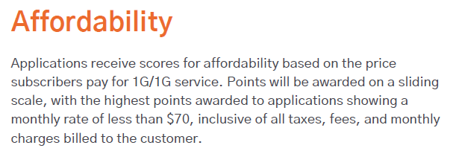
Affordability Scoring–Priority Broadband Projects

Slide 77
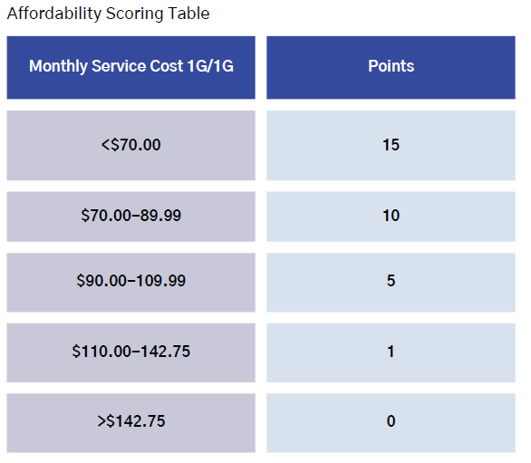
Affordability Scoring–Priority Broadband Projects

Slide 78
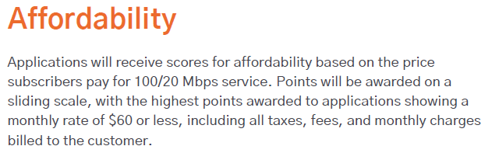
Affordability Scoring–Other Last Mile Broadband Deployment Projects

Slide 79
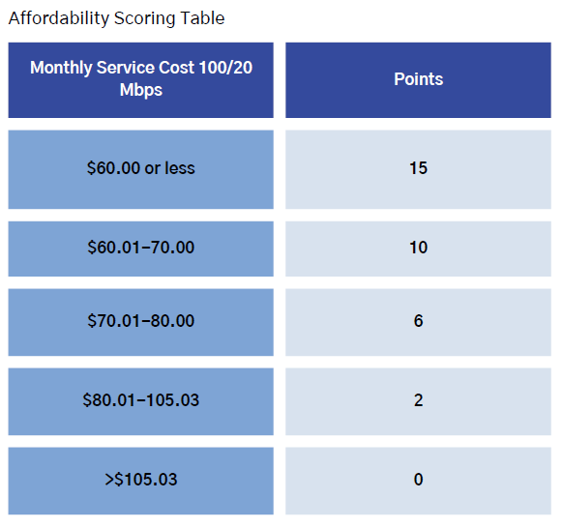
Affordability Scoring–Other Last Mile Broadband Deployment Projects

Slide 80
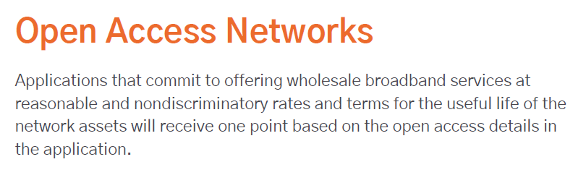
Open Access Networks Scoring–Priority Broadband Projects

Slide 81
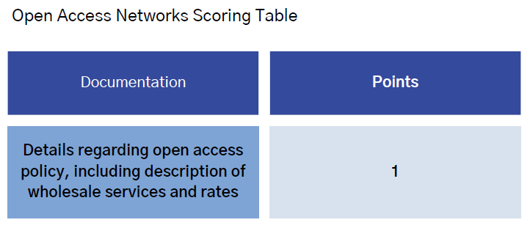
Open Access Networks Scoring–Priority Broadband Projects

Slide 82
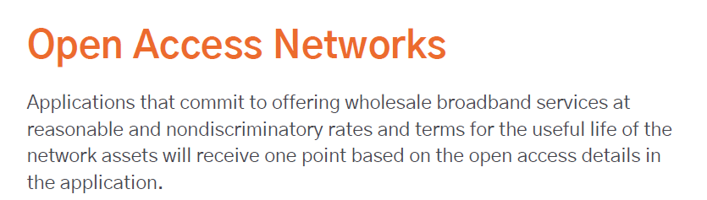
Open Access Network Scoring–Other Last Mile Broadband Deployment Projects

Slide 83
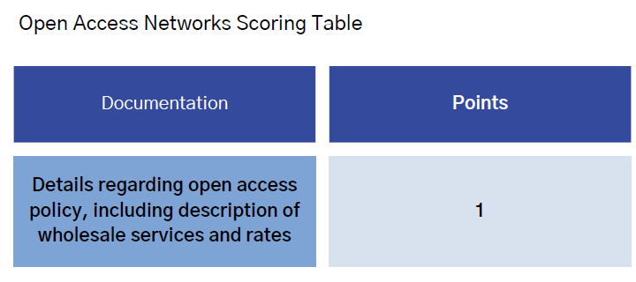
Open Access Networks Scoring–Other Last Mile Broadband Deployment Projects

Slide 84

Local and Regional Coordination
Scoring criteria for both priority and other last mile broadband deployment projects
Purpose: Ensure that applicants have met with Local and Tribal governments in a formal capacity to determine the community’s broadband needs and gain approved formal demonstrations of consent from the local government
Notes:
IP Vol 2:
Definition: Local coordination is required to ensure that applicants have formerly met with Local and Tribal governments at an open public and noticed meeting to determine their communities' broadband and digital connectivity needs and gain support through resolutions or other approved formal demonstrations of consent.
Scoring: To receive full points for this category, prospective subgrantees must demonstrate extensive community coordination, local planning,and support for the proposed project from the community.
● Community Coordination at a Local or Tribal Public Meeting–Applications that demonstrate meaningful community coordination and local planning can receive up to full points in this category. Understanding the infrastructure and service needs in the Project Funding Areas requires network planning, design, and the voice of the residents. Evidence such as an agenda and minutes or notes from Local or Tribal noticed public meetings where the broadband coordination is discussed must be submitted to be awarded full points. UBC expects applicants to share their rate plans, low-cost service plans, terms and conditions, service commitments, and billing formats to local officials of each Project Funding Area in their county or city. Locally-held discussions on permitting, rights of way, pole attachments, franchise agreements, permits, ROW agreements, or other easement needs are encouraged and noted or provided in the application review.
Resolution of Support– Applications will receive full points if they include a Resolution or other approved formal demonstrations of consent from Local government leaders (i.e. county commissioners, city councils, and/or Local government officials, including department heads of planning commissions) during the open public and noticed meeting obtained during or as a result of the public meeting described above. Local leaders may provide a resolution, other approved formal demonstration of consent for one or more applicants for the same Project Funding Area.
Zero points will be awarded for applications without this documentation. Local leaders may provide a resolution or approved formal documentation of support for one or more applicants for the same
Community Impact– 7 Points 3 Definition: A high priority of this grant is engagement with the impacted community. The applicant is to work with the local community, including regional government organizations as needed such as 12 For Tribal engagement, relevant documents demonstrating holistic coordination between the Tribal Government and applicant, may include but are not limited to, current Tribal Business license and Tribal Access Permits issued by the Tribal Government to applicant or an executed agreement between the Tribal Government and applicant that grants applicant the ability to provide Broadband services on Tribal Lands. This will ensure that the proper documentation is obtained for submission and approval of the Final Proposal. NTIA A

Slide 85
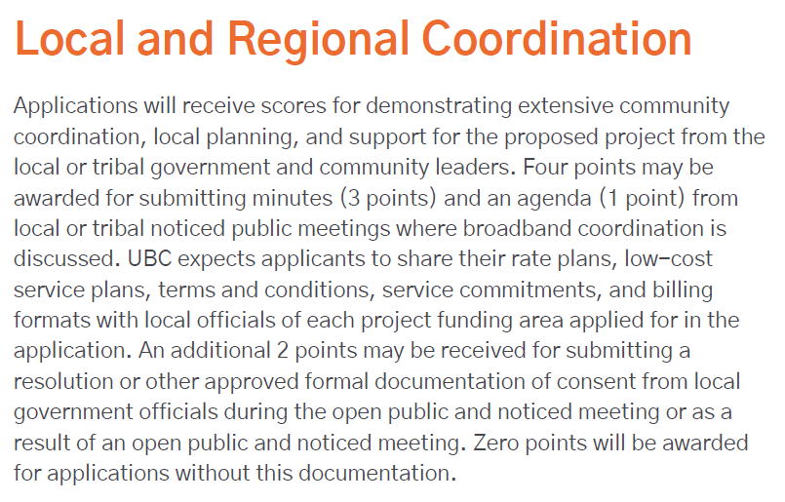
Local and Regional Coordination Scoring–Priority Broadband Projects

Slide 86
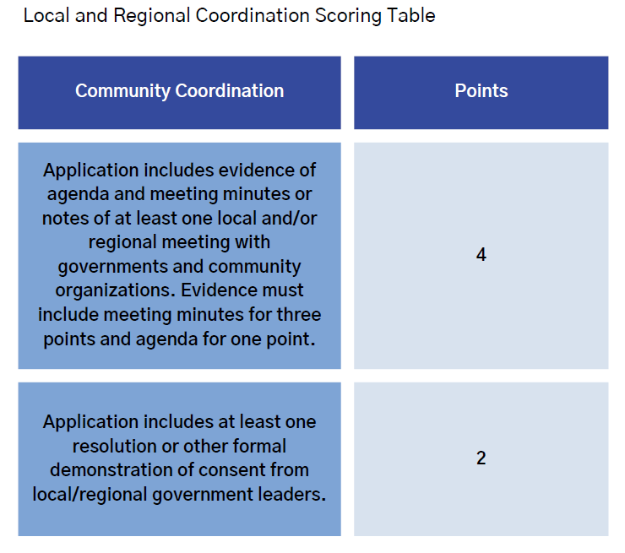
Local and Regional Coordination Scoring–Priority Broadband Projects

Slide 87
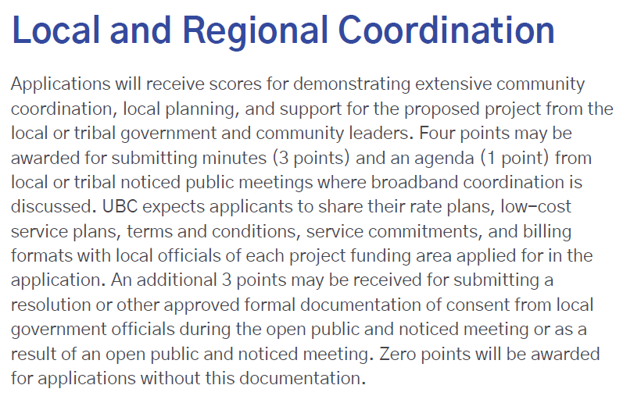
Local and Regional Coordination Scoring–Other Last Mile Broadband Deployment Projects

Slide 88
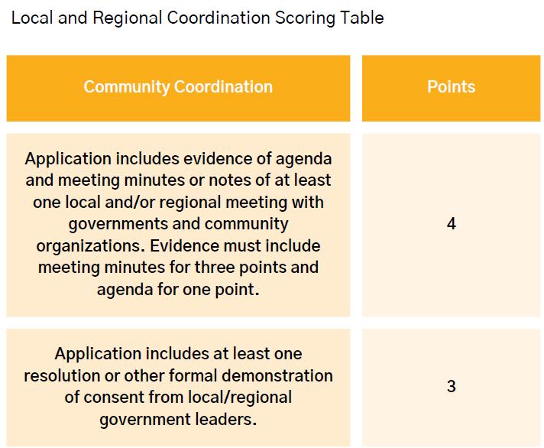
Local and Regional Coordination Scoring–Other Last Mile Broadband Deployment Projects

Slide 89

Community Impact
Scoring criteria for both priority and other last mile broadband deployment projects
Purpose: Ensure that applicants have engaged with the impacted community to identify an innovative means of providing a long-term public benefit that addresses the community’s needs
Notes:
IP Vol 2:
Community Impact
Definition: A high priority of this grant is engagement with the impacted community. The applicant is to work with the local community, including regional government organizations as needed such as Associations of Governments, to identify an innovative means of providing a public benefit that addresses the community’s needs and includes, as a component of the proposed project, a long-term public benefit to the impacted community. Prospective subgrantees must demonstrate extensive community engagement and local planning.
Scoring: To receive full points for this category, prospective subgrantees must detail an innovative means of providing a public benefit that addresses the community’s needs and that may include a broadband component or other long-term public benefit that addresses the community’s needs. Plans may also include evidence of locally held outreach meetings such as open town hall meetings with residents and businesses from the Project Funding Areas where they are applying. Points can be received for signed Letters of Support from a community organization. These letters must indicate outreach and engagement with local civic and community organizations, educational, chambers of commerce, business leaders, etc. These letters can include reference to the long-term benefit to the community as a result of outreach, collaboration, and engagement between the provider and the community. The plan should also include a detailed description of how the public benefit will be sustained over time and who will be impacted by this benefit. See the following table for detailed scoring information. Examples of the long term public benefit may include:
● Provide symmetrical broadband service to previously unserved or underserved Community Anchor Institution(s) (libraries, police and fire stations, city/county buildings, public safety buildings, hospitals, healthcare facilities, and educational institutions.
● Provide symmetrical broadband service to previously unserved or underserved public, nonprofit, or community facilities that do not meet the state’s BEAD definition of Community Anchor Institution but still provide a necessary public service to the community. These may include locations such as public water treatment and utility facilities or other facilities that would not be funded or served with BEAD funds.
● Serve an economically distressed area
● Digital literacy training
● Low-income assistance
● Partner with or establish co-working space
● Activities planned to increase adoption, including low-cost offerings for three years
● Open Community Wifi at a public location

Slide 90
Community Impact
Examples of potential long term public benefits (not an exhaustive listing):
Provide symmetrical 1G broadband service to previously unserved or underserved community anchor institutions | Low-income assistance
Provide symmetrical 1G broadband service to other previously unserved or underserved public, nonprofit, or community facilities | Partner with or establish co-working space
Serve an economically distressed area | Carry out activities planned to increase adoption, such as low-cost offerings
Digital literacy training | Open community Wi-Fi at a public location
Notes:
IP Vol 2:
Community Impact
Definition: A high priority of this grant is engagement with the impacted community. The applicant is to work with the local community, including regional government organizations as needed such as Associations of Governments, to identify an innovative means of providing a public benefit that addresses the community’s needs and includes, as a component of the proposed project, a long-term public benefit to the impacted community. Prospective subgrantees must demonstrate extensive community engagement and local planning.
Scoring: To receive full points for this category, prospective subgrantees must detail an innovative means of providing a public benefit that addresses the community’s needs and that may include a broadband component or other long-term public benefit that addresses the community’s needs. Plans may also include evidence of locally held outreach meetings such as open town hall meetings with residents and businesses from the Project Funding Areas where they are applying. Points can be received for signed Letters of Support from a community organization. These letters must indicate outreach and engagement with local civic and community organizations, educational, chambers of commerce, business leaders, etc. These letters can include reference to the long-term benefit to the community as a result of outreach, collaboration, and engagement between the provider and the community. The plan should also include a detailed description of how the public benefit will be sustained over time and who will be impacted by this benefit. See the following table for detailed scoring information. Examples of the long term public benefit may include:
● Provide symmetrical broadband service to previously unserved or underserved Community Anchor Institution(s) (libraries, police and fire stations, city/county buildings, public safety buildings, hospitals, healthcare facilities, and educational institutions.
● Provide symmetrical broadband service to previously unserved or underserved public, nonprofit, or community facilities that do not meet the state’s BEAD definition of Community Anchor Institution but still provide a necessary public service to the community. These may include locations such as public water treatment and utility facilities or other facilities that would not be funded or served with BEAD funds.
● Serve an economically distressed area
● Digital literacy training
● Low-income assistance
● Partner with or establish co-working space
● Activities planned to increase adoption, including low-cost offerings for three years
● Open Community Wifi at a public location

Slide 91
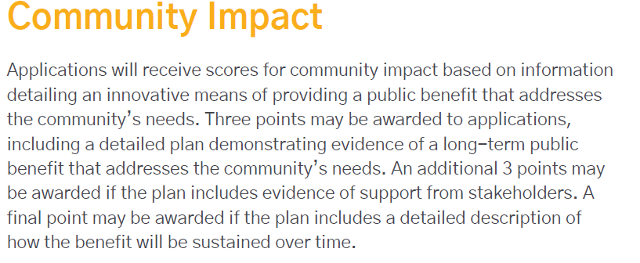
Community Impact Scoring–Priority Broadband Projects

Slide 92
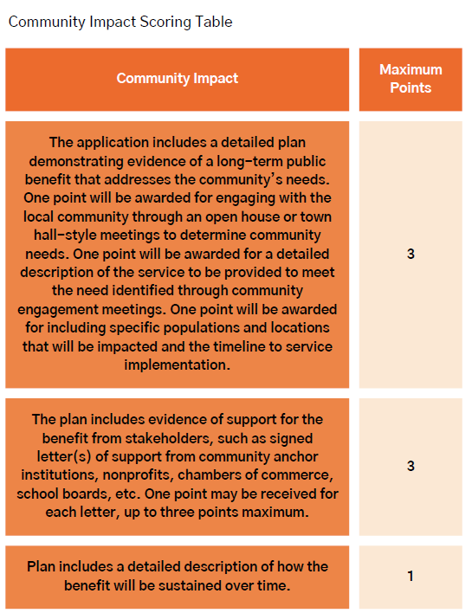
Community Impact Scoring–Priority Broadband Projects

Slide 93
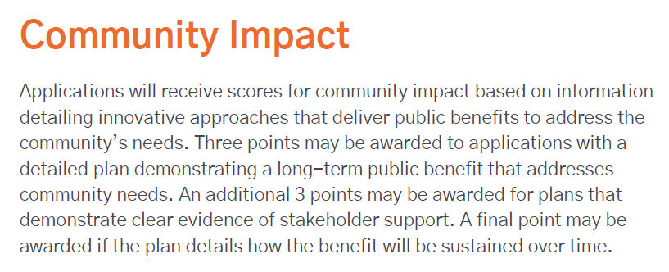
Community Impact Scoring–Other Last Mile Broadband Deployment Projects

Slide 94
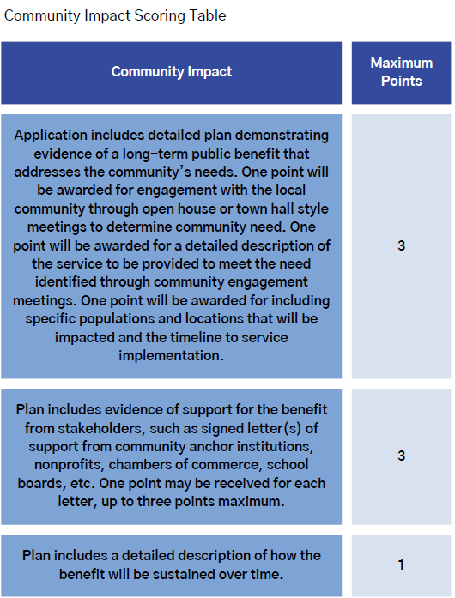
Community Impact Scoring–Other Last Mile Broadband Deployment Projects

Slide 95
Financial Capability
Pro Forma Financial Statements
Actuals for FY 2023-24 and forecasts for FY 2025-27
Provide a narrative of the assumptions used
Consider
Historical performance | Financing activities
Project timelines | Macroeconomic factors
Capital expenditures | Revenue and expense projections

Slide 96
Conditional Programmatic Waiver (1 of 2)
Letter of Credit | Performance Bond
Issued by bank or credit union with Weiss safety rating of B− or better | Issued by surety company (insurance company, bank)
25% of subaward | 100% of subaward
Requires an opinion letter from legal counsel regarding bankruptcy non-interference | Bankruptcy letter not required

Slide 97
Conditional Programmatic Waiver (2 of 2)
Options for Letters of Credit and Performance Bonds
Reduction Upon Completion of Milestones | Alternative Initial Percentage
Reduced based on milestone completions | 10% until all locations are complete
Reimbursed upon completion of milestones | Reimbursement is for periods of no more than 6 months

Slide 98
Relevant links:
Letter of credit waiver
Initial Proposal Vol. 2: 2.4.11 Ensuring Minimum Financial Capability (p. 57)
BEAD NOFO Financial Capability (p. 72)
Financial Questions?
Robert Busch
rbusch@utah.gov

Slide 99
Starting the BIG BEAD Application

Slide 100
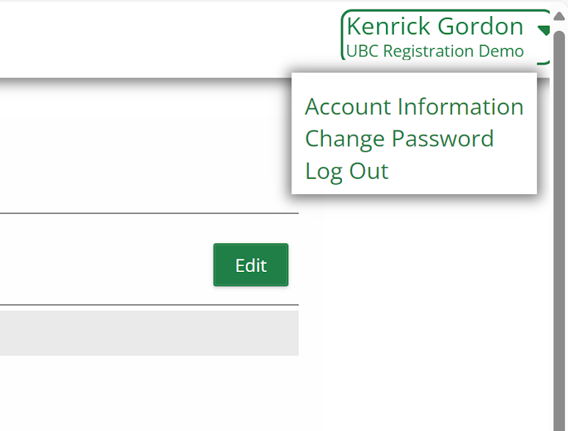
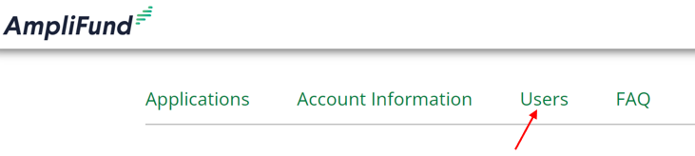
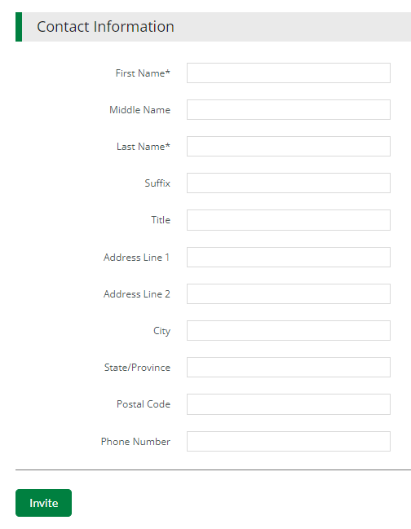
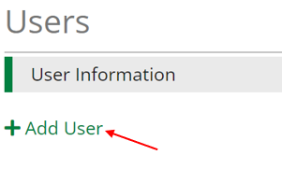
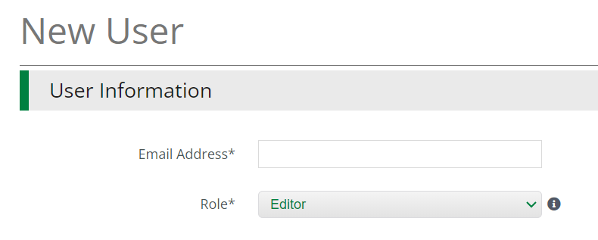
Inviting Additional Users
Additional users can be added to your AmpliFund account to assist with completing the
Formal Application
If a user is associated with another applicant, they will need to use the email +1 method to be added to your account.
Joe@consultant+1.com

Slide 101
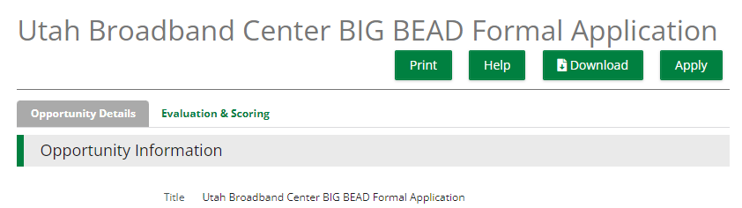
BIG BEAD Formal Application - 1
The Opportunity Details page will have important information on the BEAD Formal Application program and process. Make sure you review the contents of this page before starting your Application.
When you are ready to start your Application, click Apply

Slide 102
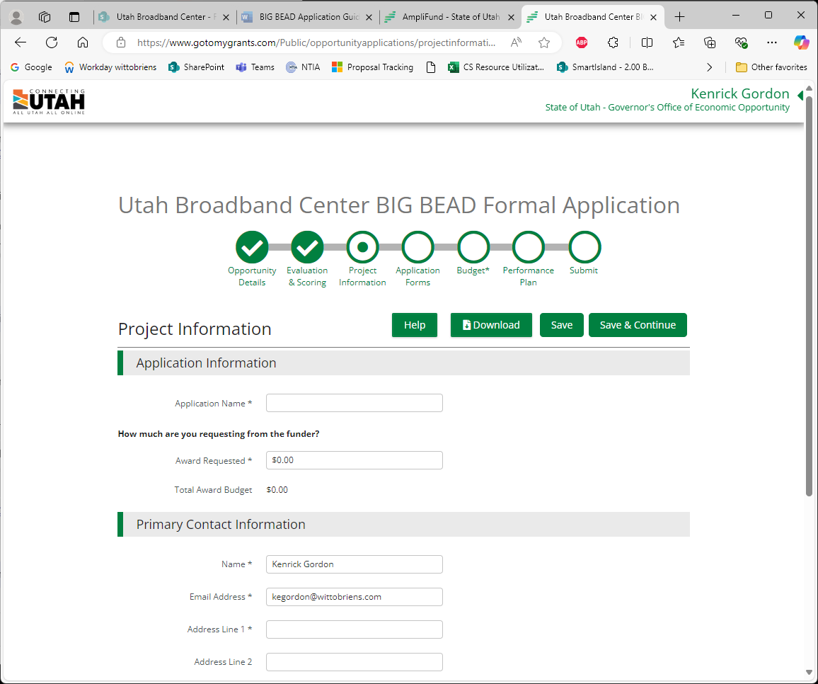
BIG BEAD Application - 2
The BIG BEAD Formal Application will have 6 tabs to complete prior to submitting. Progress on the 6 tabs can be tracked at the top of the page. You can jump between the tabs by selecting them directly.
Prior to submitting your BIG BEAD Formal Application, all tabs (circles) must be marked complete.

Slide 103
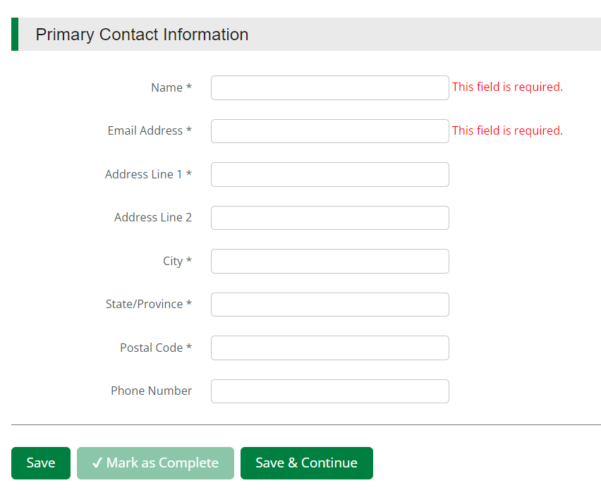
BIG BEAD Application - 3
Project Information Tab – Application Information & Primary Contact Information
Give your Application a unique name
In the Award Requested field enter your requested grant amount

Slide 104
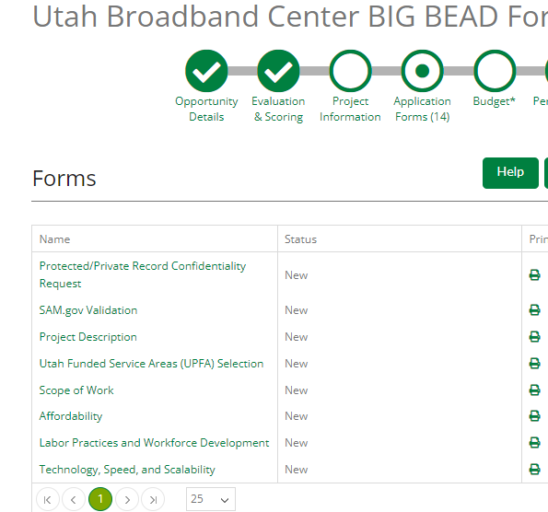

BIG BEAD Application - 4
  Click on the “Protected/Private Record Confidentiality Request” form to open and start the Application
  When working on a form, click:
  Save to save your progress;
  Mark as Complete to save the page and mark as complete; or
  Save & Continue to save your progress and move to the next page

Slide 105

BIG BEAD Formal Application Guide
The Portal Guide available at
https://business.utah.gov/broadband/grants/

Slide 106

Project Information
Information Requested
  Most of the form should be completed based on your previous registration.
  The “Amount Requested” line should be completed – it is the grant amount you’ll be requesting
  The grant amount must agree with your grant budget that will be completed later. If the numbers don’t match, you will receive an error

Slide 107

Application - Form & Budget Sections
Forms
Budget Form is located on its own tab
  Each form must be completed prior to a submission being accepted

Slide 108
Application - 14 Forms
Sections match the portal forms - walk through guide and portal together
Protected/Private Record Confidentiality Request
SAM.gov Validation
Utah Funded Service Areas (UPFA) Selection
Project Description
Scope of Work
Affordability
Labor Practices and Workforce Development
8. Technology, Speed, and Scalability
9. Local and Regional Coordination
10. Letter of Credit or Performance Bond
11. Financial Pro-Forma Documentation
12. Additional Funding
13. Reporting and Compliance
14. Certification

Slide 109

Utah Project Funding Area (UPFA) Selection
Information Requested
  Select the desired UPFA and complete the provided csv file
  There is a link to the UPFA map to allow applicants to review the locations of the UPFA’s as they make selections

Slide 110

Project Description and Project Narrative
Information Requested
  The Project Description is a short description that could be released to the public should a project award be made.
  The Project Narrative is a more detailed presentation of the project. For example, requiring information such as:
    Project’s Community Benefit
    Service Offerings
    Technology Type
    Upgrades to Existing Networks
    Design Parameters
    Areas of Risk
    Network Maintenance

Slide 111

Scope of Work
Information Requested
  The Scope of Work describes the activities and services to be performed for the project.
    Describe specific project activities to be undertaken as part of the project
    Who will carry out the work
    Construction schedule with milestones

Slide 112

Affordability
100/100 Mbps
100/100 Mbps
Information Requested
  Select the speed the project will meet or exceed
    1 Gbps/1 Gbps
    100/100 Mbps
    100/20 Mbps
  Provide the price you will commit to charging for each level of service

Slide 113

Technology, Speed, and Scalability
100/100 Mbps
100/100 Mbps
Information Requested
  Speed to Deployment
    Proof of ROW, easement, pole attachments, etc.
    Permit process
    Network design
    Material bill of sales
  Open access - wholesale offering
  Alternative Technologies
    Provide a description of the technology
  Technology proposed

Slide 114

Local and Regional Coordination
Information Requested
  Evidence of jurisdictional contact
    Resolutions
    Meeting minutes
    Agendas
  Evidence of long term public benefit
  Community Letters of Support

Slide 115

Letter of Credit or Performance Bond
Information Requested
  Certification that the applicant understands that a LOC or Performance Bond is required

Slide 116

Financial Pro-Forma Documentation
Information Requested
  Provided pro-forma form – 2 year historic, 3 year projection
  Balance Sheet
  Income Statement
  Cash Flow Statement
Assumptions uploaded as a pdf
Instructions are provided in Appendix C of the Application Guide

Slide 117

Additional Funding
Information Requested
  Matching Contribution
    25% minimum match required
  Demonstrate availability of funds
    Cash on hand
    Outside funding
    In-kind match

Slide 118

Reporting and Compliance
Information Requested
  Certification that the applicant understands that there are reporting and compliance requirements that flow with the funds.

Slide 119

Certification
Information Requested
  Before submitting your Application, an authorized representative of your organization must agree to various attestation statements.
  To agree with the attestation statements, the authorized representative should type their name, their title and choose the date you are submitting the Application. This is equivalent to a written signature; therefore, please ensure a company officer or someone who can legally bind the applicant is taking this action and submitting the application.

Slide 120

Submitting your BIG BEAD Formal Application
  Once all forms have been filled out successfully, mark them as complete. Checkmarks will appear above each section that is marked as complete. Once all sections are marked complete, the “Submit” button will turn green.
To submit your Pre-application, click on the green “Submit” button.

Slide 121

Submitting your BIG BEAD Formal Application (continued)
You will receive a success notification on your screen once your Pre-application has been submitted.
Click the green “Application” button to download a PDF copy of your submitted Pre-application.

Slide 122
BIG BEAD Formal Application
Project Description
Provide a brief description of your project that may be shared publicly. The limit for the description is 250 words.

Slide 123
BIG BEAD Formal Application
Project Narrative
Provide a detailed Project Narrative for the selected UPFA(s) describing:
  Project community benefit
  Description of the system to be deployed
  Network Maintenance and Management Plan
  Alternative Technology justification, if proposing alternative technology
  Rights-of-Way and/or easements available or required
  Permitting: Federal, State, Local
  Pole attachments owned or needed
  Infrastructure Privileges or Access that would assist with the project
  Outreach and Engagement Plan for hiring/contracting opportunities
  Local workforce hiring plan
Unless mentioned, there is no word or character limit for the inputs

Slide 124
BIG BEAD Formal Application
Scope of Work
Describe the activities to be performed as part of the project
  Describe the construction activities
  Describe the materials to be installed, where and how
  Describe who will carry out the work
    In-house workers
    Contractors
Provide a construction build schedule
  Quarterly Activities
  Milestones
  Include all major build-out phases (Design, Permitting, Outside Plant, Customer Install, etc.)
  Include assumptions regarding the project supply chain

Slide 125
BIG BEAD Formal Application
Project Budget
Budgets will be uploaded using the budget forms provided
Budget Categories
  Administrative and Legal Expenses
  Land, structures, rights-of-way, appraisals
  Architectural and engineering fees
  Project inspection fees
  Site work
  Construction - Sub-Categories Required
  Miscellaneous
  Cash Match
  In-Kind Match

Slide 126
BIG BEAD Formal Application
Project Budget cont.
Construction Budget Sub-Categories
  Electronic Equipment (cabinets, switches, routers, wireless radios, etc.)
  UPFA Last Mile Outside plant (fiber, coaxial)
  Middle Mile/Interconnection Outside plant - (fiber, coaxial)
  Customer Drops
  Customer premises equipment
  Bandwidth Costs
  Other ineligible costs necessary for the project

Slide 127
Eligible and Ineligible Budget Costs
Eligible Costs | Ineligible Costs
Capital Construction Costs | Operating Expenses
Purchase or lease of vehicles used primarily for construction | Pre-Application costs
Long Term Leases including IRU agreements | Pre-Award Costs
Engineering design, permitting | Acquisition of an affiliate or an affiliate’s facilities or equipment
Personnel Costs directly related to the project | Operating Leases
Network software upgrades | Merger or consolidation of entities
Post-Award Monitoring | Costs incurred in acquiring spectrum
Notes:
BIG: Broadband Infrastructure Grant

Slide 128
BIG BEAD Formal Application
Reporting and Compliance
Applicants must indicate that they understand that they are required to:
Submit project and expenditure reports as required by NTIA
Data regarding project expenditures and status
Equity indicators,
Community engagement efforts
Programmatic data, and other measures as determined by the awarding entity
Provide information as necessary for UBC to comply with its reporting requirements
Comply with various other Federal requirements
Prohibitions on certain telecommunications and video surveillance services or equipment
Build American Buy American Act
Clean Water Act
Environmental and Historic Preservation processes (EHP) aka NEPA/Section 106
Davis Bacon Act

Slide 129
BIG BEAD Formal Application – Things to Know
Build American Buy American (BABA)
Self-Certification: Manufacturers, at the risk of federal penalty, can choose to certify that certain equipment they produce meets the domestic manufacturing requirements described in the BEAD BABA waiver.
Manufacturer’s BABA certification letter: Manufacturers are required to provide a BABA certification letter to a subgrantee for equipment that requires domestic production in the BEAD BABA waiver.
  Subgrantees are required to maintain this certification letter in the event of an audit.
Subgrantees will be required to report certain information on finished waived electronics used in BEAD deployments.

Slide 130
BIG BEAD Formal Application – Things to Know
Environmental and Historic Preservation processes (EHP)
  National Environmental Protection Act (NEPA)
    Categorical Exclusions
    Fiber/Coax on existing poles
    Trenching/Plowing/Boring in existing ROW’s
    New tower equipment on existing towers
  Section 106 Historic Preservation
    State Historic Preservation Officer (SHPO)
    Tribal Historic Preservation Officer (THPO)

Slide 131
BIG BEAD Formal Application – Things to Know
Davis Bacon Requirements
For projects over $5 million, the Davis Bacon Act applies, and prevailing wages must be paid
Prevailing wages can be found in SAM.gov based on the county where construction is taking place.
Prevailing wages can be requested from the US Department of Labor
Wage reporting
  You may submit weekly payroll records for all workers including in-house, contractor or subcontractor.
  You may self certify that all workers including in-house, contractors and subcontractors meet this requirement.
    You must maintain adequate documentation related to the self certification

Slide 132
Link to the Formal Application in AmpliFund

Slide 133

Visit: broadband.utah.gov
Email: connectingutah@utah.gov
Call: 801-538-8680
Attend: Weekly Office Hours
Tuesdays at 10:00 AM from January 28-March 25

Slide 134

STAKEHOLDER ANNOUNCEMENT
USDA Seeks Applications for Grants to Build Community-Oriented High-Speed Internet Networks for People in Rural Areas
WASHINGTON, Jan. 10, 2025 – U.S. Department of Agriculture (USDA) Rural Development Under Secretary Dr. Basil Gooden today announced that USDA is accepting applications for grants to build community-oriented, high-speed internet networks for people in rural areas.
The Department is making up to $26 million in grants available under the Community Connect Program. This program provides funds to establish high-speed internet networks that will foster economic growth and deliver enhanced educational, health care and public safety benefits.
The application window opens on Feb. 20, 2025. Applications must be submitted electronically through the Agency’s online application intake system at https://www.rd.usda.gov/community-connect no later than 11:59 a.m. ET on April 21, 2025.

Slide 135
THANK YOU

